Slide 1

WELCOME UNIT 1

Slide 2

HOW OFTEN DO YOU STUDY PROGRAMMING?
UNIT 1 | CYCLE 2

Slide 3

IN THIS UNIT, YOU WILL LEARN ABOUT:
The present.
Frequency adverbs.

Slide 4
LET’S PLAY BINGO!
Let’s practice some vocabulary through a virtual bingo card.
https://myfreebingocards.com/bingo-card-generator/free/xrcxbwx

Slide 5
REVIEW
SIMPLE PRESENT TENSE

Slide 6

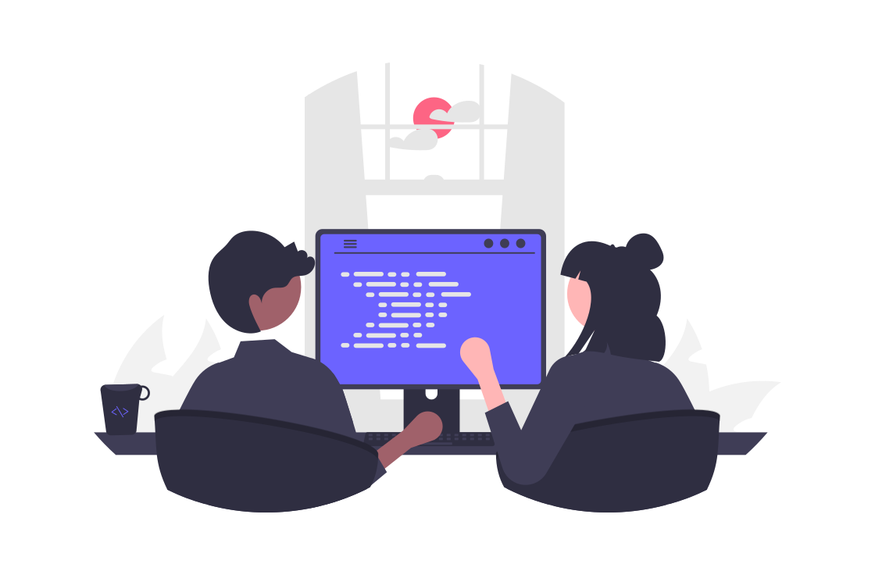
No, I don’t. I am only a customer. What do you do here?
Do you work here?
I am a software designer at this company. What about you?
I work at a tech company too.

Slide 7
READING
Highlight the sentences that use the present structure.
Rosa, the CEO of Motorola, says that she always carries a laptop with her since it is relevant to upload updated information about the customers. Moreover, she posts news on the official website of the company in order to catch the clients’ attention. Finally, she says that her colleague, Martha, also uses a social network to be in contact with the clients.
What can you identify in the sentence?
How can you identify a present structure?
What about the verbs?

Slide 8
GRAMMAR SPOT

Slide 9
PRESENT SIMPLE
AFFIRMATIVE
SUBJECT | VERB | COMPLEMENT
I – You- We- They | transfer | money every month.
He- She- It | transfers | money every month.
S or ES

Slide 10
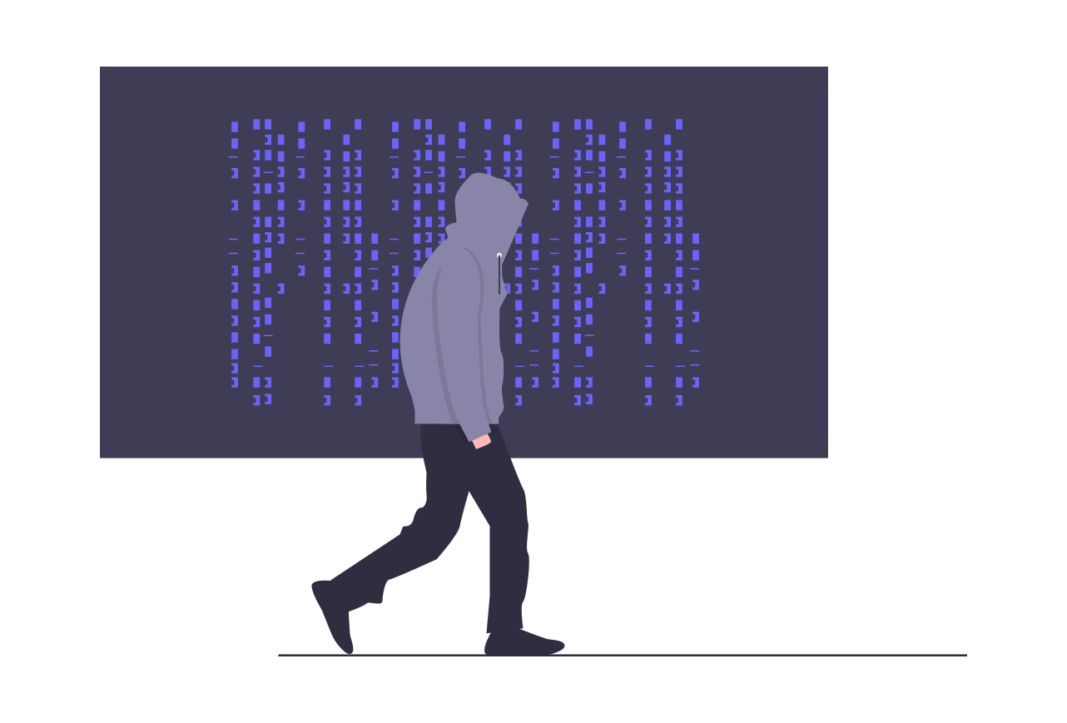
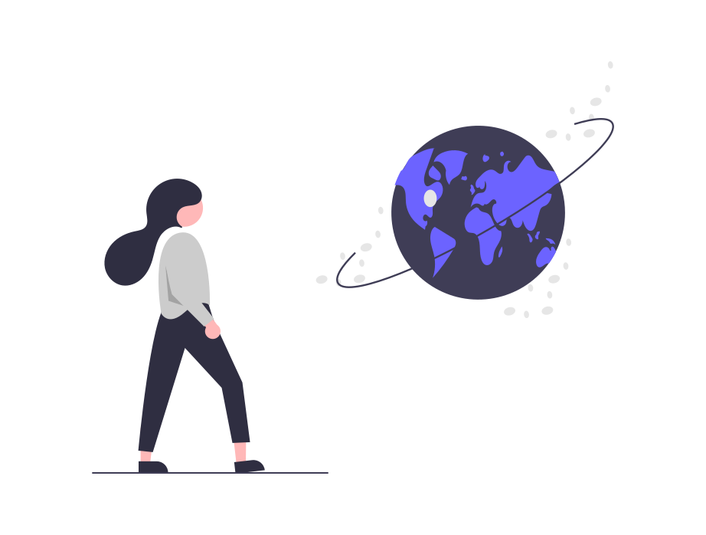
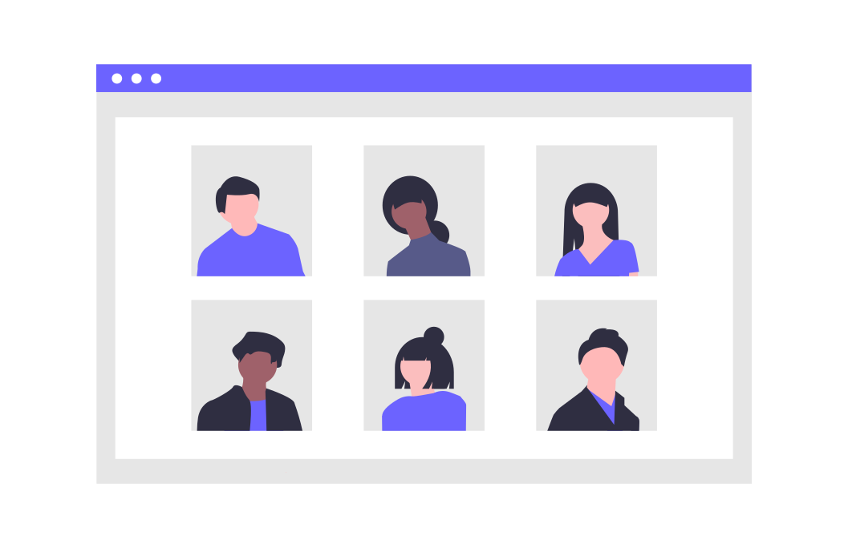
PRESENT SIMPLE
AFFIRMATIVE
I work as a programmer.
She understands English.
We study in Misión TIC.

Slide 11
PRESENT SIMPLE
AFFIRMATIVE
He
-es | O, -CH, -SH, -SS, -X, Z | - Search- Searches - Fix – Fixes - Kiss- Kisses
-ies | CONSONANT + Y: Remove the “Y” and add -ies | - Study- Studies - Copy- Copies - Carry- Carries
-s | VOWEL + Y: Just add -s | - Enjoy- Enjoys - Say- Says - Play- Plays
 | In general, we add -S in the third person. | Surf- Surfs Erase – Erases Design- Designs
She
It
*Third person singular.

Slide 12
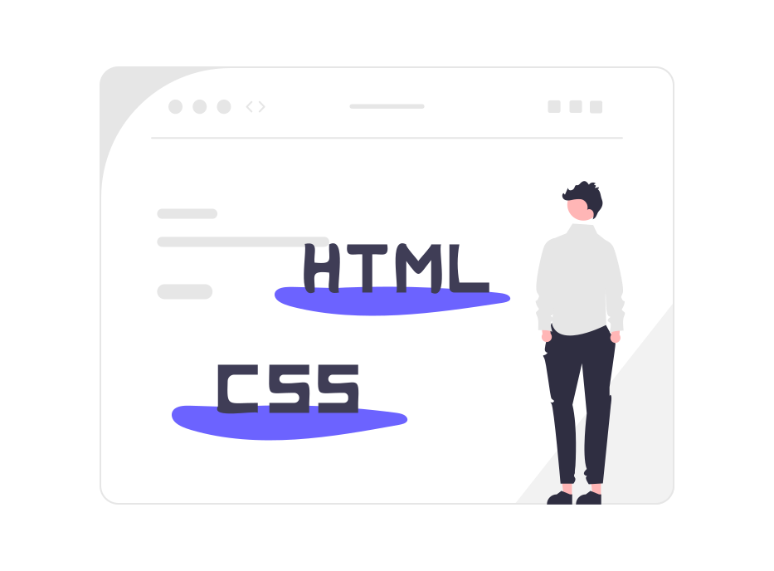
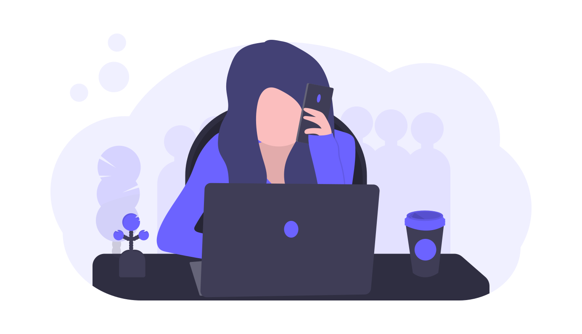
PRESENT SIMPLE
AFFIRMATIVE
Mauricio manages three programming languages.
She drinks coffee every day.

Slide 13
PRESENT SIMPLE
NEGATIVE
SUBJECT | DO NOT / DOES NOT | VERB | COMPLEMENT
I – You- We- They | do not | transfer | money.
He- She- It | does not | transfer | money.
Don’t
Doesn’t

Slide 14
PRESENT SIMPLE
AFFIRMATIVE
Mauricio doesn’t manage three programming languages. He manages only one.
I drink coffee every day.

Slide 15
LET’S PRACTICE!
Go to iMaster platform and practice about the present simple.
https://wordwall.net/es/resource/13970794

Slide 16
VERBS TO HAVE AND TO GO

Slide 17
TO HAVE
AFFIRMATIVE
SUBJECT | VERB | COMPLEMENT
I – You- We- They | have | some marketing material.
He- She- It | has | some marketing material.

Slide 18
TO HAVE
NEGATIVE
SUBJECT | DO NOT / DOES NOT | VERB | COMPLEMENT
I – You- We- They | do not | have | some marketing material
He- She- It | does not | have | some marketing material
Don’t
Doesn’t

Slide 19


3
Do we have a project?
1
2
Does Manuela have the codes to program our project?
Yes, of course! She has all the codes.
TO HAVE

Slide 20
TO GO
AFFIRMATIVE
SUBJECT | VERB | COMPLEMENT
I – You- We- They | go | to the company every week.
He- She- It | goes | to the company every week.

Slide 21
TO GO
NEGATIVE
SUBJECT | DO NOT / DOES NOT | VERB | COMPLEMENT
I – You- We- They | do not | go | to the company.
He- She- It | does not | go | to the company.
Don’t
Doesn’t

Slide 22
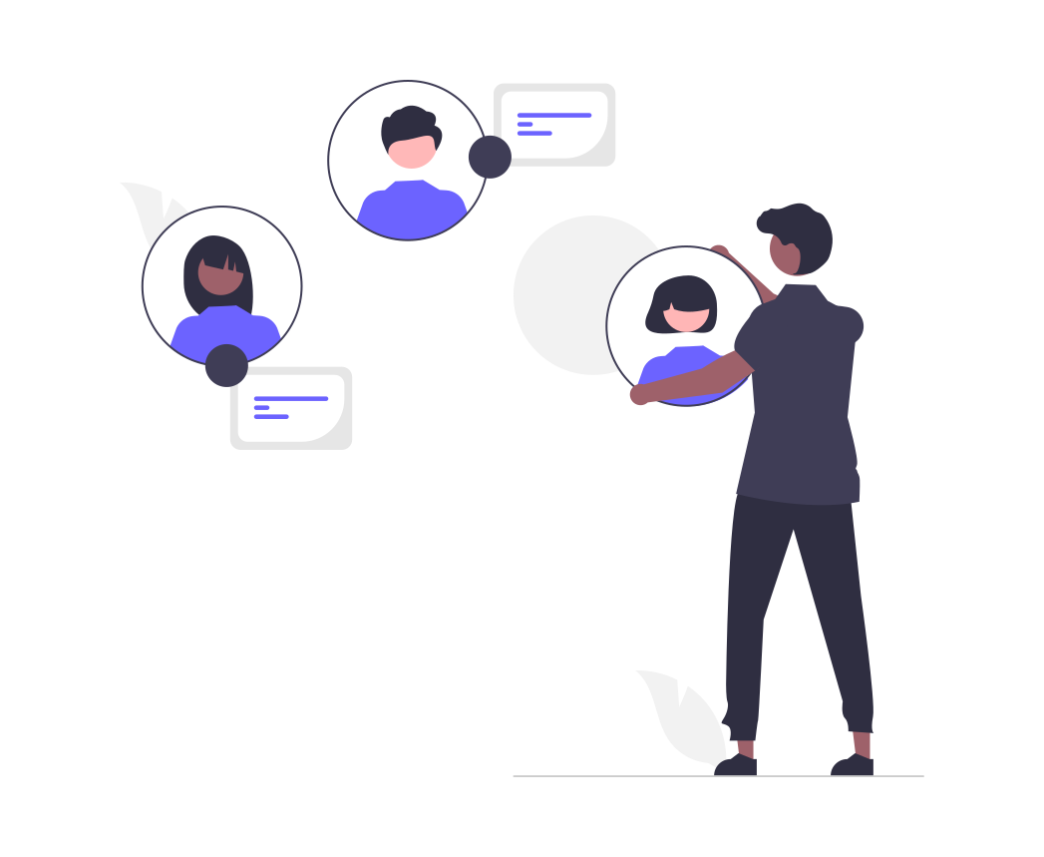
3
I think so.
2
1
Is it mandatory to go?
We go to a technological festival on Saturday.
TO GO

Slide 23
READING
Fill in the gaps with the correct form of the verbs “to have” and “to go”. Then, answer the questions below.
The company TECH.IN a lot of customers because of its low prices and variety of technology. Many people every day for buying laptops, cellphones, cameras, etc. For instance, Brandon and Dolly ______ _ one of the newest smartphones on the market. It a lot of functionalities such as displaying the weather and taking notes through voice dictation. When a person to this company as a referral, this person receives a 10 percent discount.

Slide 24
READING
Fill in the gaps with the correct form of the verbs “to have” and “to go”. Then, answer the questions below.
has
The company TECH.IN _______ a lot of customers because of its low prices and variety of technology. Many people __________ every day for buying laptops, cellphones, cameras, etc. For instance, Brandon and Dolly _______ _ one of the newest smartphones on the market. It __________ a lot of functionalities such as displaying the weather and taking notes through voice dictation. When a person _________ to this company as a referral, this person receives a 10 percent discount.
go
have
has
goes

Slide 25
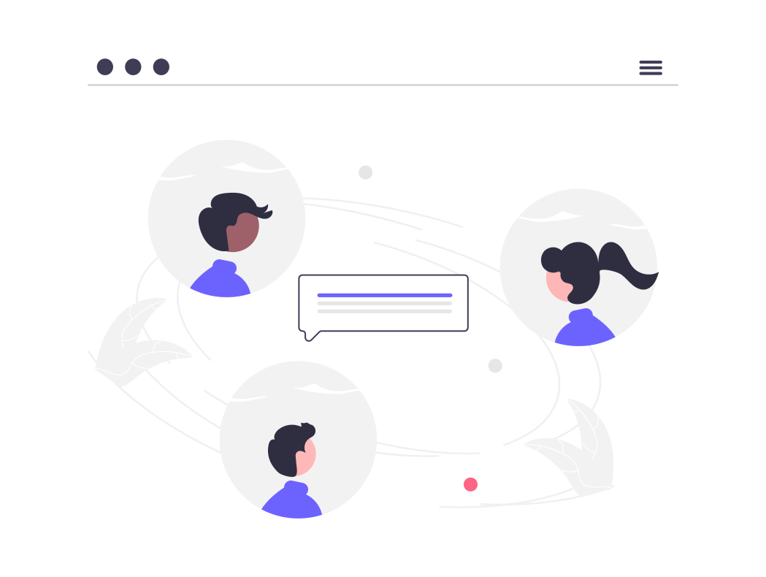
PRESENT
Do we meet on Saturday?
Do you have the codes?
Does he speak English and French?

Slide 26
GRAMMAR SPOT

Slide 27
YES – NO QUESTIONS
DO
DOES
I – You – We - They
He- She - It

Slide 28
DO | DOES
YES/NO QUESTIONS
DO/DOES | SUBJECT | VERB | COMPLEMENT | ?
Do | you | study | programming
Does | Manuela | design | online courses
Yes, I do.
No, I don’t

Slide 29
Do you…? / Does she…?
Answer the questions.
Does Mary install any program for listening to music?
________________________________________________
Does Carlos upload many pictures to his social networks?
________________________________________________
Do they copy the files to a specific folder?
________________________________________________

Slide 30
LET’S PRACTICE
Complete the dialogue with the correct form of the verb.

Slide 31
ACTIVITY
Complete the dialogue with the following verbs
do (x2)
not want
love
help
need
stay
organize
not know
come
Yaneth: Carlos! How are you doing?
Carlos: Hello Yaneth! Everything is fantastic! What about your family?
Yaneth: My parents ________ at home. Carlos, my birthday is on February 12th. I want to have my party at the Convention Center. Would you like to ________?
Carlos: Of course!
Yaneth: My family and friends______that place. _______ you know a person who _______events? I _______ to plan ahead everything.
Carlos: Yes, I ____. I can ________you with this. I __________if he is available but I will ask him.
Yaneth: Thank you so much. I ___________to have my party at my house because it is small.

Slide 32
ACTIVITY
Complete the dialogue with the following verbs
do (x2)
not want
love
help
need
stay
organize
not know
come
Yaneth: Carlos! How are you doing?
Carlos: Hello Yaneth! Everything is fantastic! What about your family?
Yaneth: My parents ________ at home. Carlos, my birthday is on February 12th. I want to have my party at the Convention Center. Would you like to ________?
Carlos: Of course!
Yaneth: My family and friends__________that place. __________ you know a person who __________events? I __________ to plan ahead everything.
Carlos: Yes, I _________. I can ___________you with this. I ___________if he is available but I will ask him.
Yaneth: Thank you so much. I _____________to have my party at my house because it is small.
stay
come
love
Do
organizes
need
do
help
don’t know
don’t want

Slide 33
WH WORDS

Slide 34

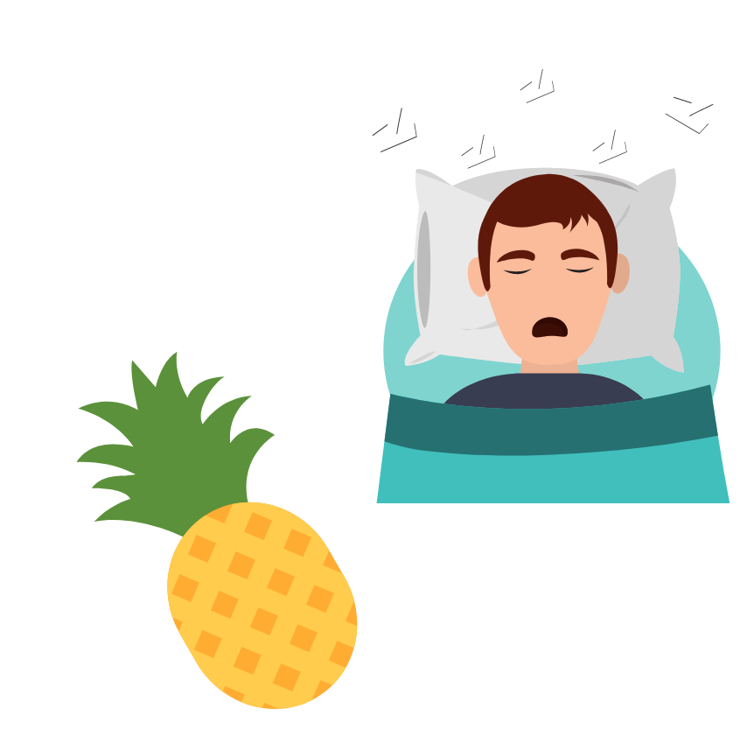
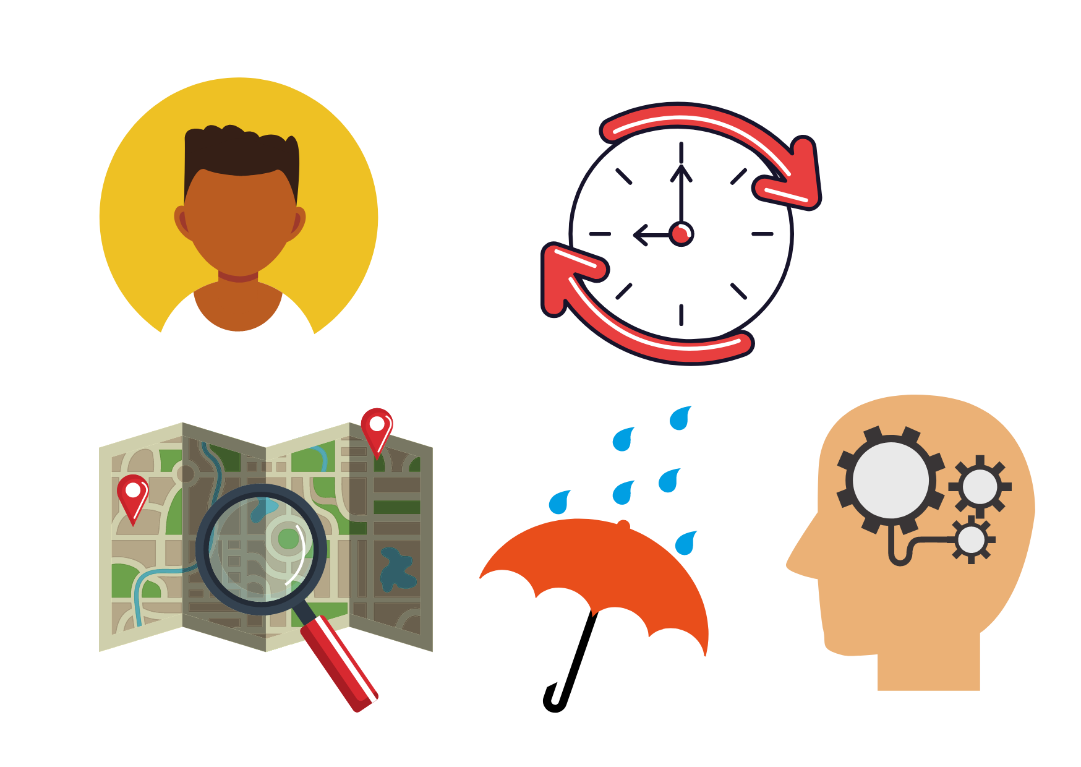
WH WORDS
WHERE
WHY
WHAT
HOW
WHO
WHEN

Slide 35

WH QUESTIONS
They are used to give an appropriate information rather than to answer “yes” or “no”.
WH | DO/DOES | SUBJECT | VERB | COMPLEMENT
What | do | you | study?
Where | does | Lina | work | on Saturdays?
When | do | they | record | their podcasts?
Why | does | he | print out | these documents?
Which laptop | do | you | prefer?
How | do | you | program | this app?

Slide 36
LET’S PRACTICE
Go to the platform and do the matching activity about the present tense.

Slide 37
READING
Based on the following text, answer the questions below:
1. Why does the company have a lot of customers?
_________________________________________
2. Which products do people buy in the company?
__________________________________________
3. Which smartphone do Brandon and Dolly have?
_________________________________________________

Slide 38
READING
Based on the following text, answer the questions below:
The company TECH.IN has a lot of customers because of its low prices and variety of technology. Many people go every day for buying laptops, cellphones, cameras, etc. For instance, Brandon and Dolly have one of the newest smartphones on the market. It has a lot of functionalities such as displaying weather and taking notes through voice dictation. When a person goes to this company as a referral, this person receives a 10 percent discount.

Slide 39
ADVERBS OF FREQUENCY
The adverbs of frequency describe how often an action happens.

Slide 40
100% | Always
90% | Usually
80% | Normally - Generally
70% | Often - Frequently
50% | Sometimes
30% | Occasionally
10% | Seldom
5% | Hardly ever - Rarely
0% | Never
ADVERBS OF INDEFINITE FREQUENCY

Slide 41

ADVERBS OF INDEFINITE FREQUENCY
Normally, I study programming.
I sometimes play videogames.
I never turn off my computer.

Slide 42
THE ADVERB IN A SENTENCE
An adverb of frequency goes before a main verb (except with TO BE).
An adverb of frequency goes after the verb TO BE.
Mike always repairs computers.
Gabriela is rarely in the programming class.

Slide 43
ADVERBS OF INDEFINITE FREQUENCY
Usually, Claire works at home.
I hook my radio up to the battery normally.
Frequently, I download music that I like.
Often, I deactivate my social networks.
I post on my social networks sometimes.
I back up my system occasionally.
Some adverbs can be placed at the start or at the end of a sentence.

Slide 44
LET’S PLAY
Go to the platform and organize the sentences in the correct order. Wordwall activity.
https://wordwall.net/es/resource/4124769

Slide 45
Number + times | Day/ Week/ Month/ Year
Once | a day
Twice | a week
Three times | a month
Four times | a year
Five times | a day
Six times | a week
ADVERBS OF DEFINITE FREQUENCY

Slide 46

ADVERBS OF DEFINITE FREQUENCY
Diego and Adriana bring out a new product twice a year.
The technician sets up our modem once a month.
Robert works at Samsung four times a week.

Slide 47
ADVERBS OF DEFINITE FREQUENCY
EVERY | TIME PERIOD
Every | day
Every | week
Every | month
Every | year

Slide 48
ADVERBS OF DEFINITE FREQUENCY
Sofia sends the e-mails to the company every day.
I transcript 25 PDF documents every week.
Raul goes to the Conventions Center every year.

Slide 49
ADVERBS OF DEFINITE FREQUENCY
Daily
The company opens daily.
I have to print out a lot of documents weekly.
I go to meetings monthly.
You need to pay the suscription annually.
Weekly
Monthly
Annually

Slide 50
ADVERBS OF DEFINITE FREQUENCY
EVERY | NUMBER | TIME PERIOD
Every | four | days
Every | three | months
Every | two | weeks
Every | five | days

Slide 51
ADVERBS OF DEFINITE FREQUENCY
They pay the suscription every two months.
There is a meeting every three weeks.
I use my laptop every two days.

Slide 52
LET’S PRACTICE
Go to iMaster platform and do the matching activity about adverbs of frequency.

Slide 53
LISTENING
Go to the platform and do the listening activity about SOCIAL MEDIA.

Slide 54
SPEAKING
Go to the platform and practice speaking using the random picker wheel.
https://wordwall.net/es/resource/29995162

Slide 55

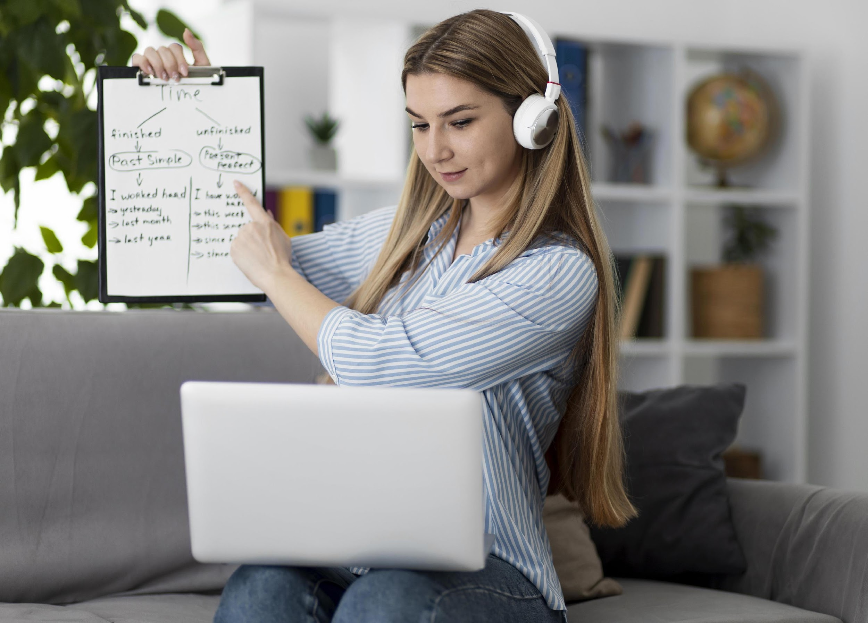
SPEAKING
*Optional part.
How often do you study programming?
How often do you have English classes?

Slide 56
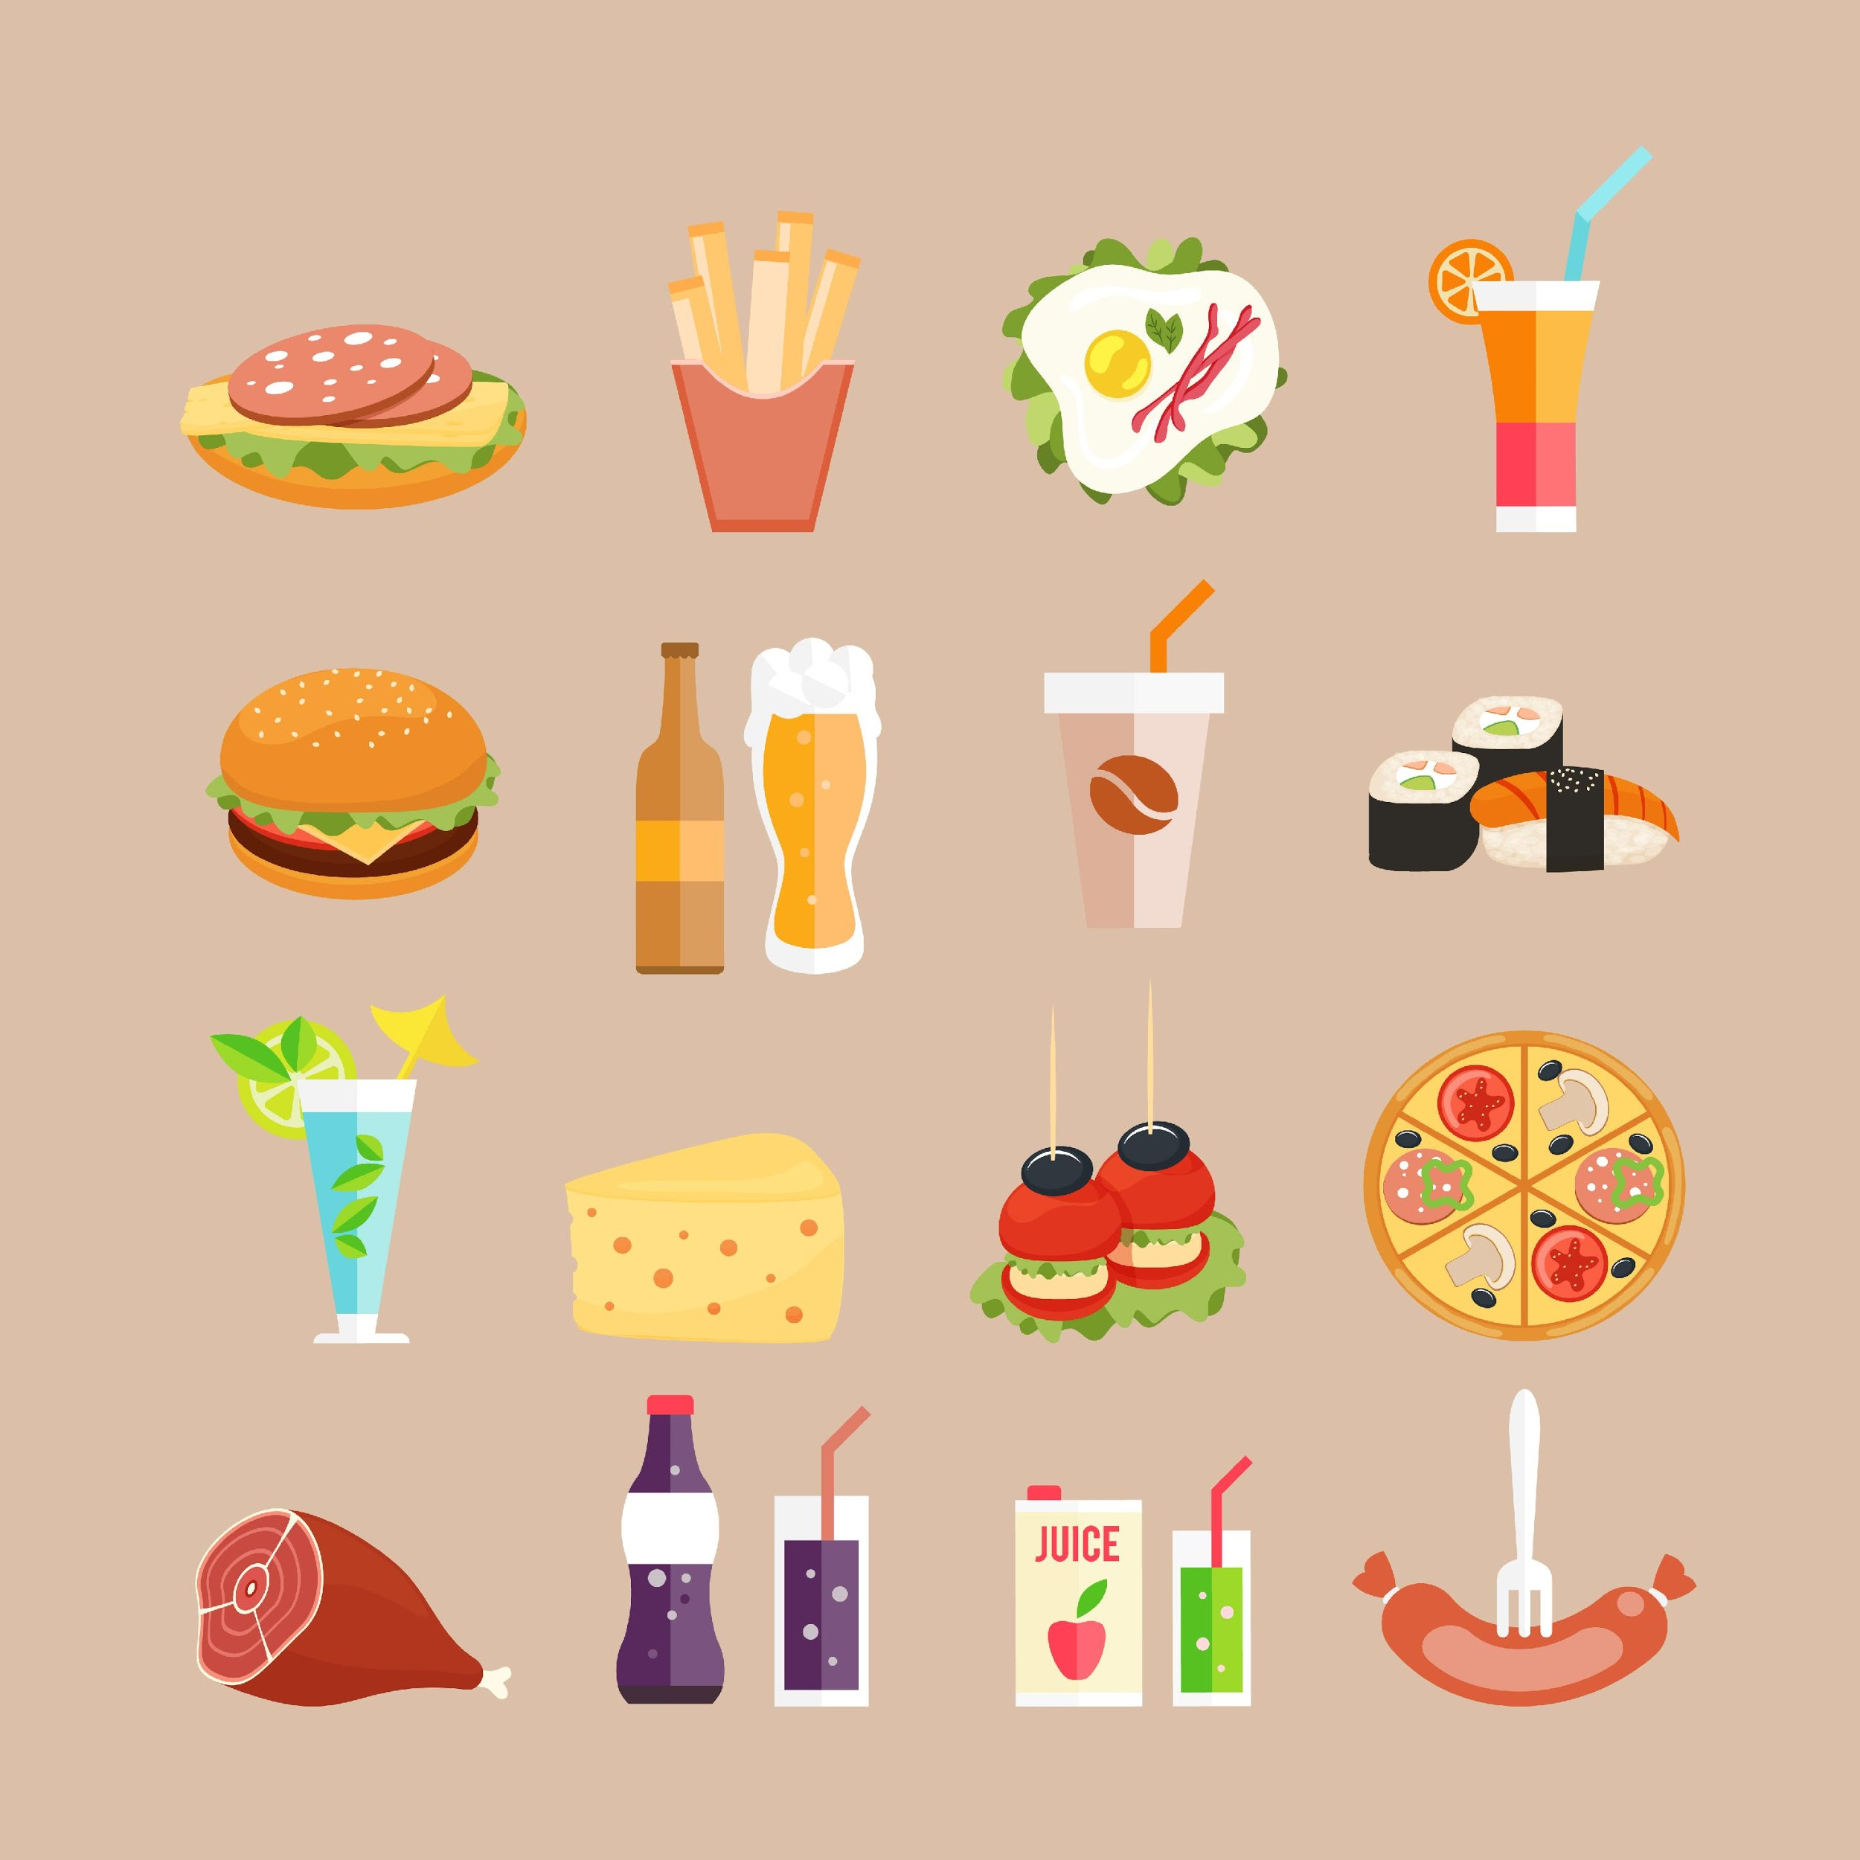

SPEAKING
*Optional part.
How often do you eat junk food?
How often do you post on your social networks?

Slide 57
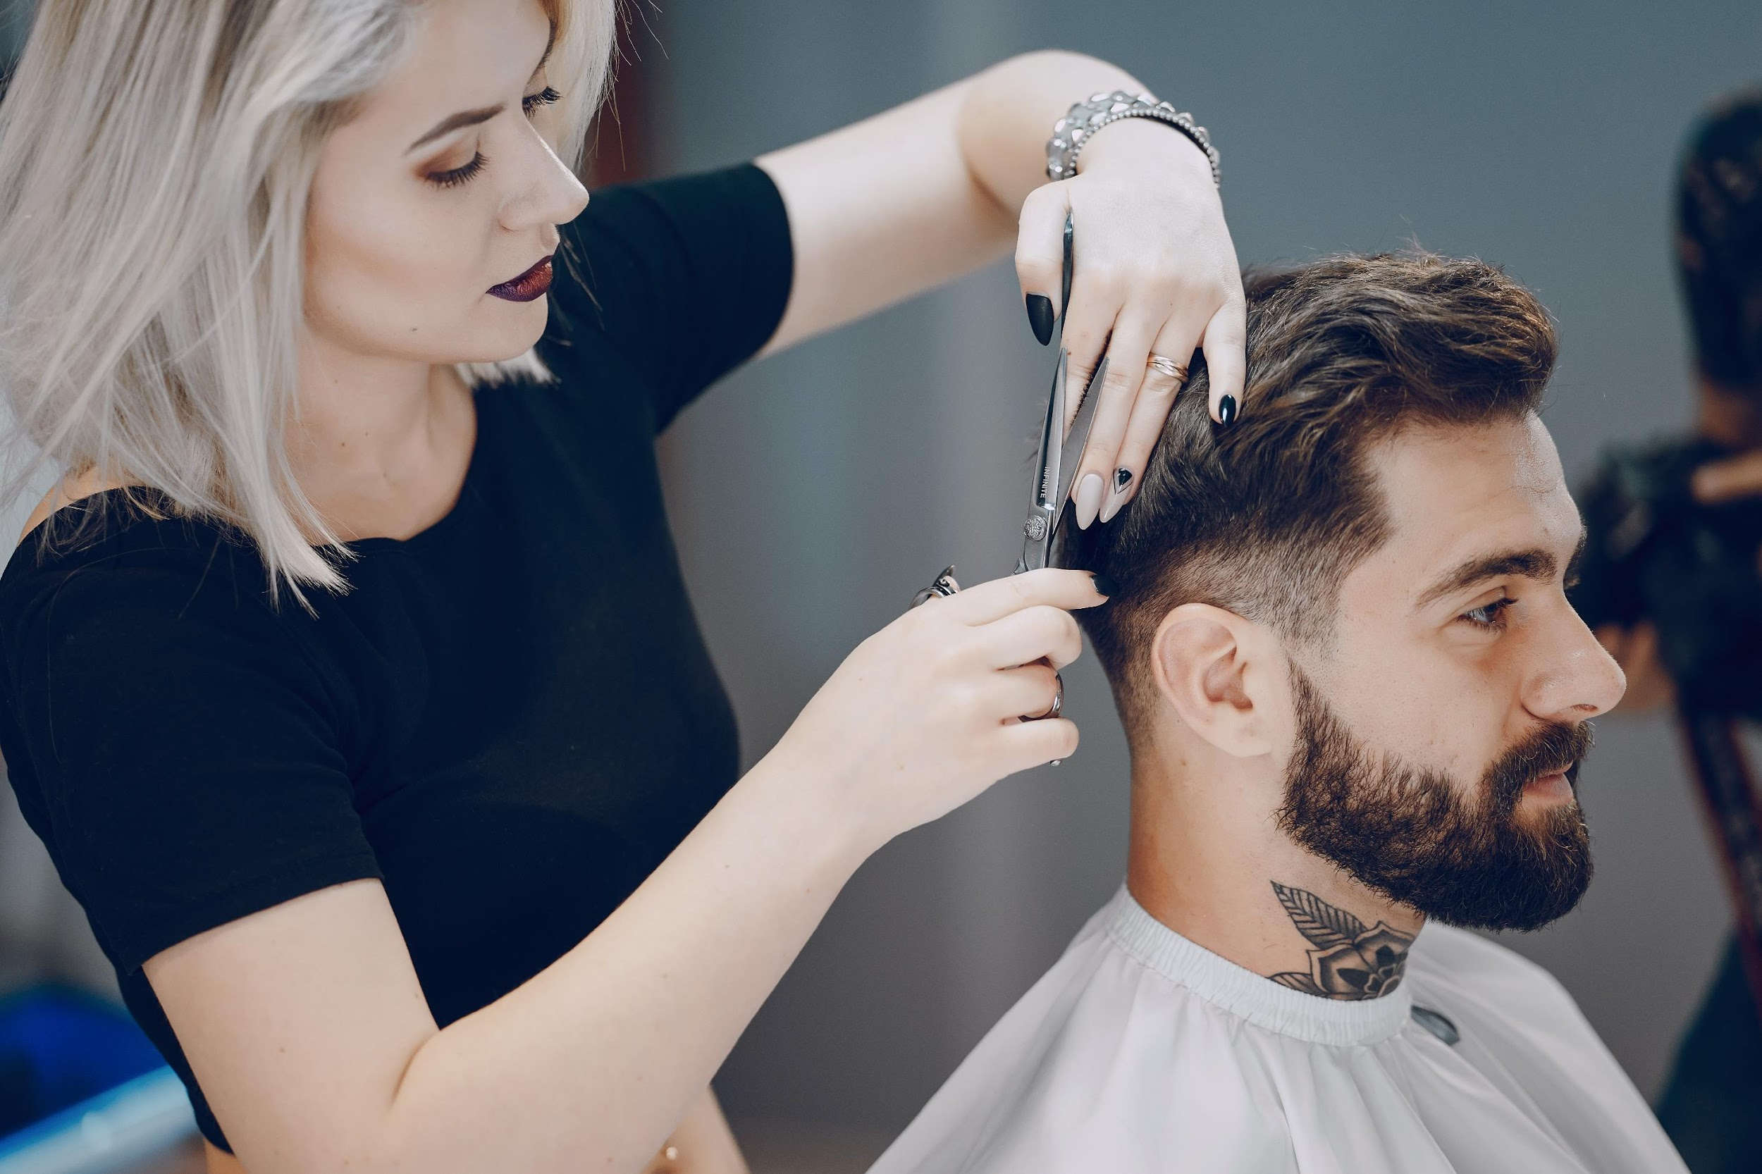
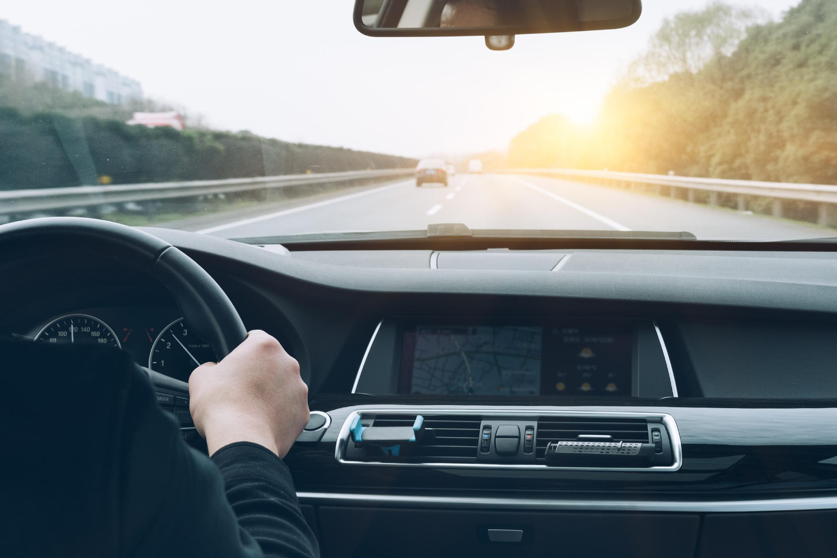
SPEAKING
*Optional part.
How often do you get a haircut?
How often do you drive a car?

Slide 58

SPEAKING
*Optional part.
How often do you back up your system?
How often do you use your social networks?

Slide 59
READING
Go to iMaster platform and do the reading activity:
Top 50 Data Structure and Algorithms Interview Questions for Programmers

Slide 60
LET’S PLAY!
Go to iMaster platform and play WHO WANTS TO BEA MILLIONAIRE. Practice the content taught in class.
https://www.superteachertools.us/millionaire/millionaire.php?gamefile=292253

