Slide 1
WELCOME UNIT 2

Slide 2
TECHNOLOGICAL CHANGES
UNIT 2 | CYCLE 2

Slide 3
IN THIS UNIT, YOU WILL LEARN ABOUT:
Comparatives.
Superlatives.
Types of adjectives.

Slide 4
LET’S TALK
Let’s talk about some gadgets that have change life.
Technology you like the most. Why?
Benefits on economy and people lives.
Advantages and disadvantages.
Impact on the environment.
Available for all.

Slide 5
LET’S PLAY
Go to iMaster platform and play anagram with some words.
https://wordwall.net/es/resource/14372129

Slide 6
LET’S REMEMBER SOME NOUNS

Slide 7
HOW CAN YOU DESCRIBE THE NOUNS WE MENTIONED?
NOUN | ADJECTIVE
ROUTER
PROGRAMMER

Slide 8
AN ADJECTIVE IS A WORD THAT DESCRIBES A NOUN

Slide 9
TYPES OF ADJECTIVES

Slide 10
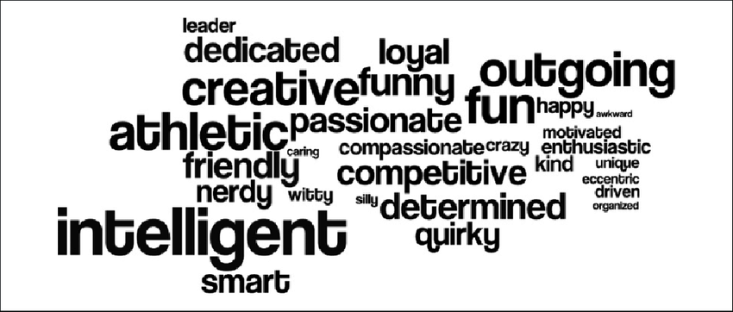
DESCRIPTIVE ADJECTIVE
1

Slide 11
PROPER ADJECTIVE
They are formed from a proper noun.
Spanish.
Shakespearean.
Martian climate.
My teacher is British.
2

Slide 12
COMPARATIVE AND SUPERLATIVE ADJECTIVES
3

Slide 13
COMPARATIVE
ADJECTIVES

Slide 14
COMPARATIVE ADJECTIVES
My mouse is smaller than my boss mouse.
My computer is bigger than yours.
The Asus processor is faster than the HP processor.
Your internet is as fast as mine.
iPhones are more expensive than motorolas.

Slide 15
ADJECTIVES WITH 1 SYLLABLE
SMALL | SMALLER THAN
BIG | BIGGER THAN
SHORT
HOT | HOTTER THAN
COLD
TALL
FAT
SAD

Slide 16
ADJECTIVES WITH 2 SYLLABLES, ENDING IN Y - IER
BUSY | BUSIER THAN
HAPPY | HAPPIER THAN
DIRTY
NOISY
CRAZY
LAZY
TINY
MESSY

Slide 17
ADJECTIVES WITH 2 OR MORE SYLLABLES
EXPENSIVE | MORE EXPENSIVE THAN
IMPORTANT
DANGEROUS
INTELLIGENT
POPULAR | MORE POPULAR THAN
MODERN
BEAUTIFUL
SUCCESSFUL | MORE SUCCESFUL THAN

Slide 18
LET’S PRACTICE!
Go to iMaster platform and play comparatives in Kahoot.
https://create.kahoot.it/share/comparatives/a67ebc1e-1c5c-48b5-9cba-4ec95b2f6f0c

Slide 19
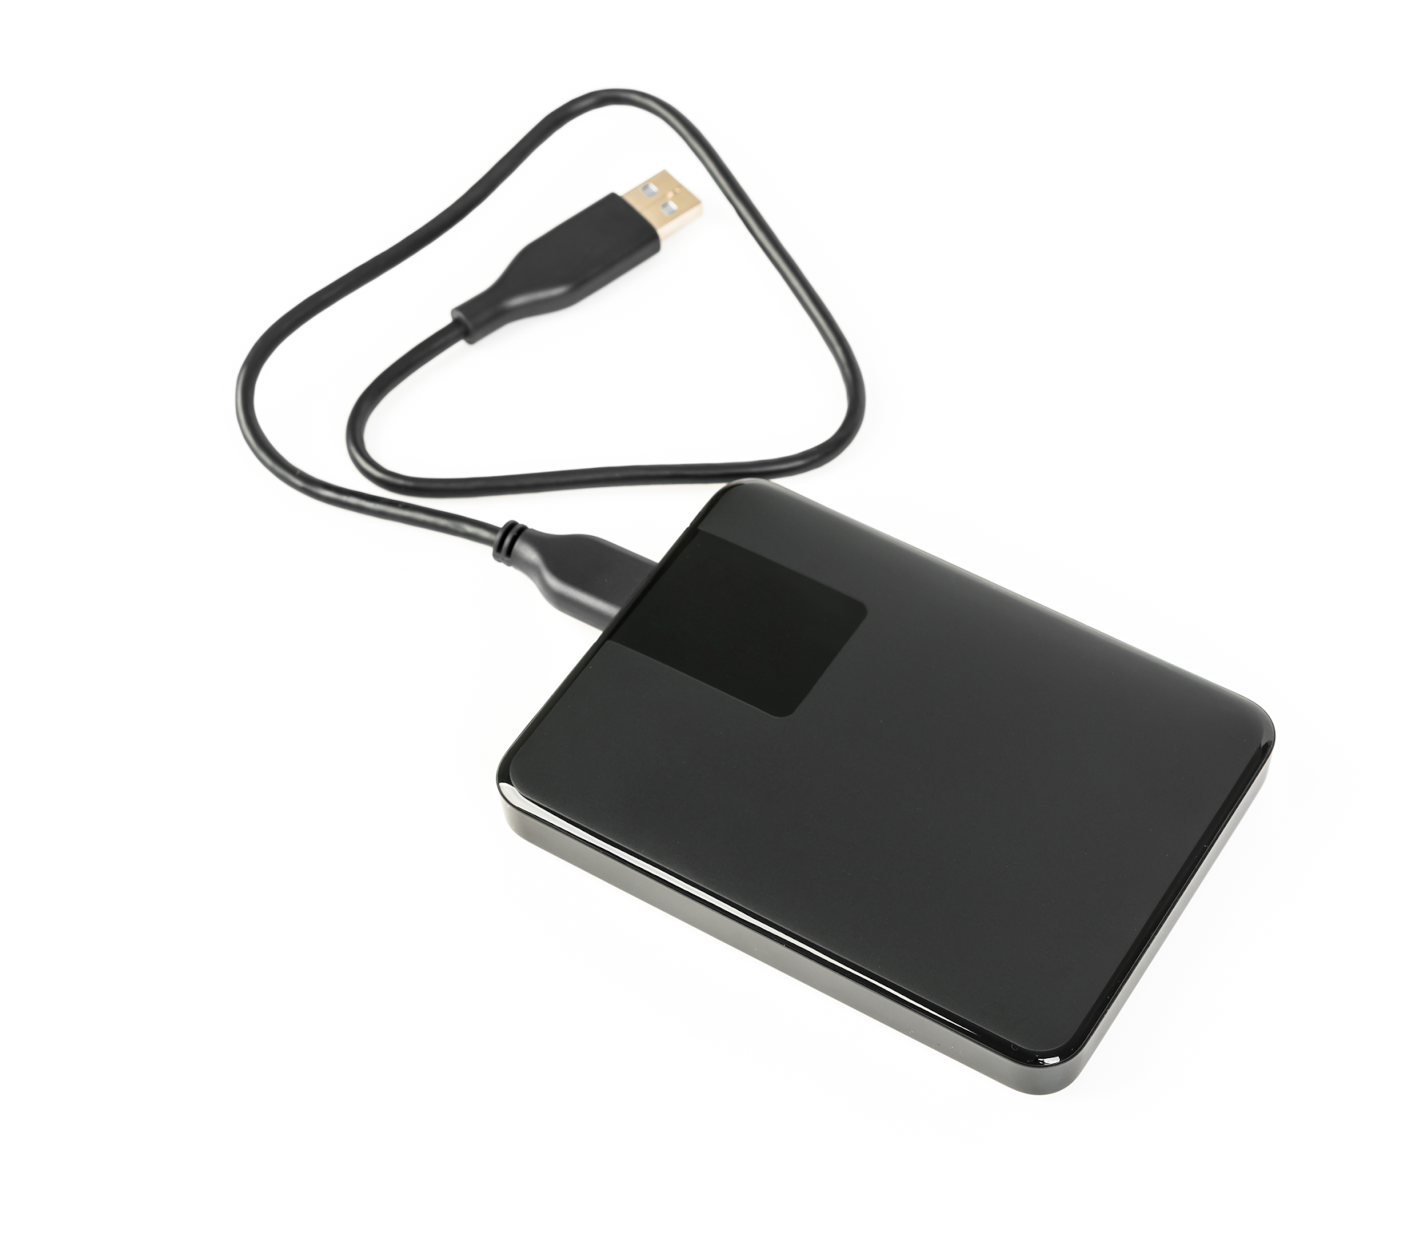
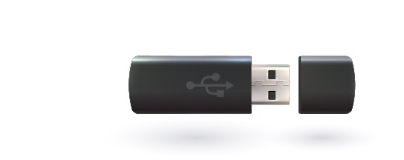
OBSERVE THE FOLLOWING IMAGES
CAN YOU COMPARE THE GADGETS?
vs
Hard disk
Pendrive

Slide 20
OBSERVE THE FOLLOWING IMAGES
CAN YOU COMPARE THE GADGETS?
vs
Apple
Samsung

Slide 21
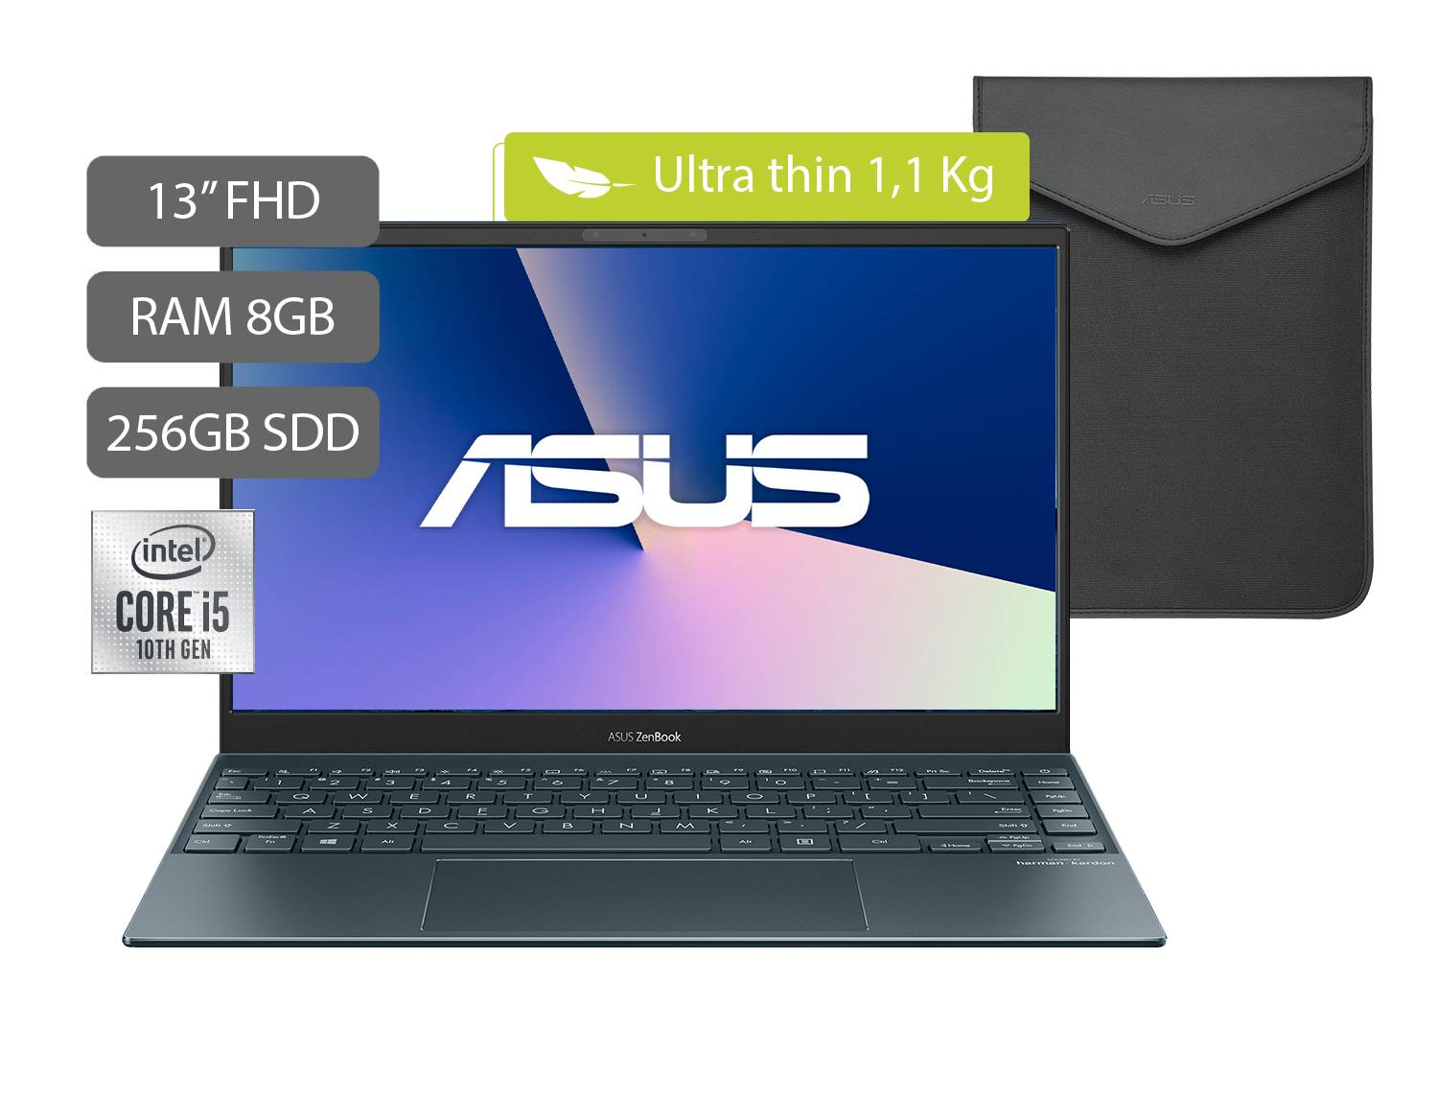
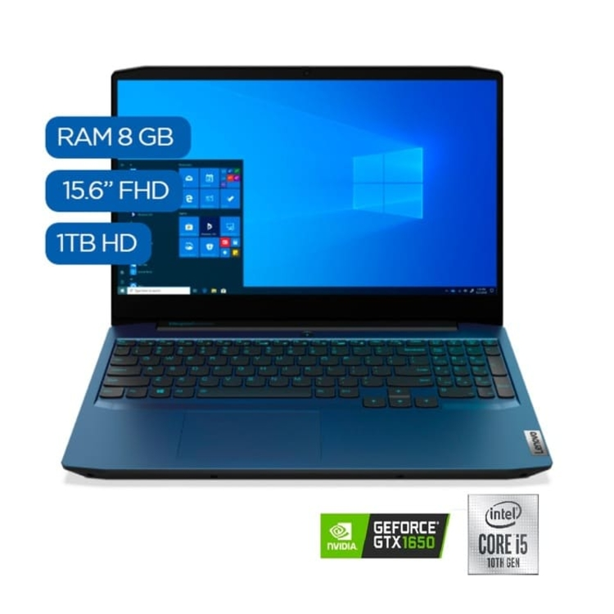
OBSERVE THE FOLLOWING IMAGES
CAN YOU COMPARE THE GADGETS?
vs
Asus
Lenovo

Slide 22
OBSERVE THE FOLLOWING IMAGES
CAN YOU COMPARE THIS TECH?
vs
Intel CORE i5
Intel CORE i3

Slide 23
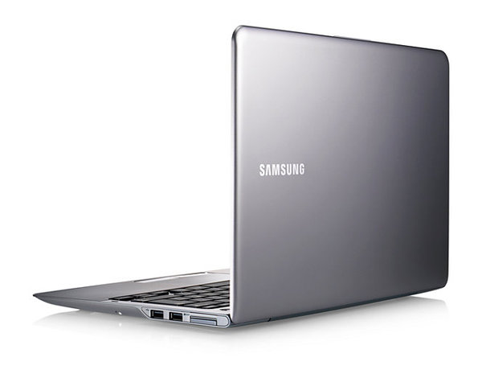
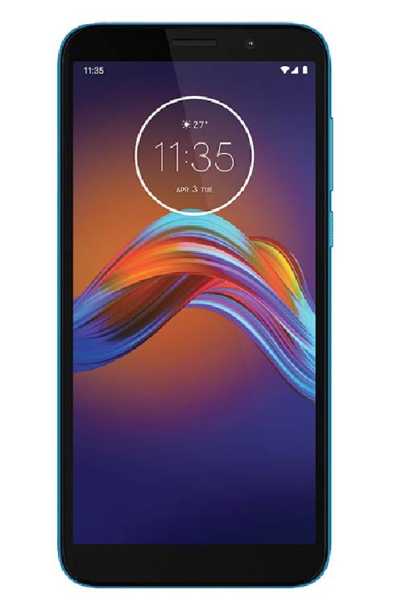
OBSERVE THE FOLLOWING IMAGES
IRREGULAR COMPARATIVES AND SUPERLATIVES
good - better - the best
In my opinion, samsung is the best Brand.
bad - worse - the worst
In my opinion, Huawei is the worst Brand.

Slide 24
ACTIVITY
Are the sentences correct or incorrect? Why? Underline the mistake.
Sebastian is funnier than Issac ______
Claudia is heavyer than Nicolás ______
My cellphone is more smaller than my computer ______
Advertising pressures women to be thinner ______
This book is more boringer than the last one ______
Martha is the older of the four sisters ______
The author´s third book is the most interesting ______
That is the sleepiest puppy of the neighborhood _______
You dance gooder than I do. ______
Coding in python is the most difficult assignment. ______

Slide 25
LET’S PRACTICE!
Go to iMaster platform and do the Live worksheet activity about comparatives.
https://es.liveworksheets.com/worksheets/en/English_as_a_Second_Language_(ESL)/Comparatives/Comparative_adjectives_sx191093gc

Slide 26
ACTIVITY
COMPLETE THE SENTENCES WITH THE CORRECT FORM OF THE COMPARATIVE OR SUPERLATIVE.
1. The _____ day of the week is Saturday.
bestest
best
goodest
2. My cousin is _____ student in his class.
the worst
worse
worst
3. Do you think volleyball is _____ than tennis?
better
best
better tan
4. Your football team is _____ than my football team.
bad
best
worse

Slide 27
ACTIVITY
COMPLETE THE SENTENCES WITH THE CORRECT FORM OF THE COMPARATIVE OR SUPERLATIVE.
1. The _____ day of the week is Saturday.
bestest
best
goodest
2. My cousin is _____ student in his class.
the worst
worse
worst
3. Do you think volleyball is _____ than tennis?
better
best
better tan
4. Your football team is _____ than my football team.
bad
best
worse

Slide 28
LESS THAN | AS … AS
INFERIORITY
EQUAL
My computer is less expensive than my sister’s computer
My cellphone is as big as yours

Slide 29
LET’S PRACTICE!
Choose two technological devices to be compared. Using the forum construct some sentences to express the advantages or disadvantages of the selected gadget.
*You need to use pictures to show the comparison.

Slide 30
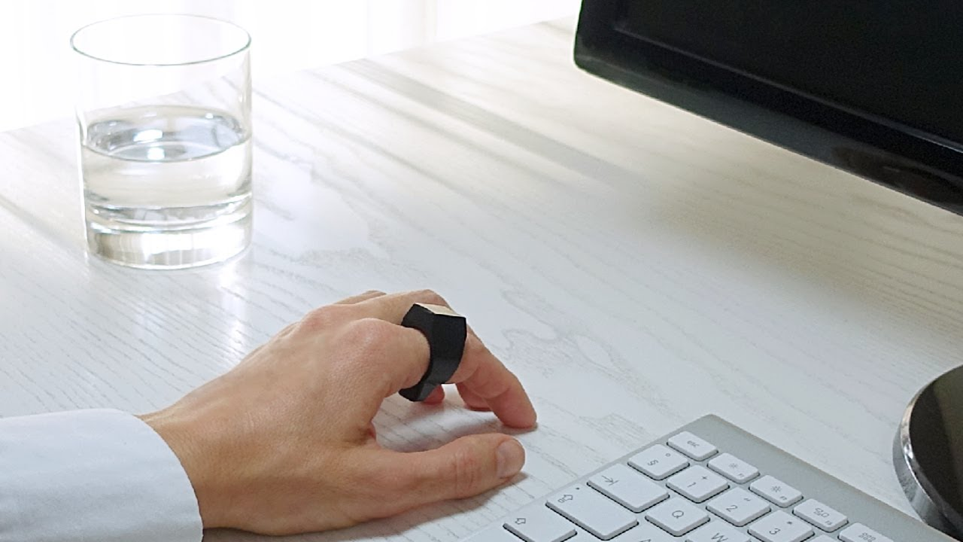
THIS IS AN IDEA
Padron Ring is better than a mouse because it is easy to carry.

Slide 31
SUPERLATIVE ADJECTIVES

Slide 32
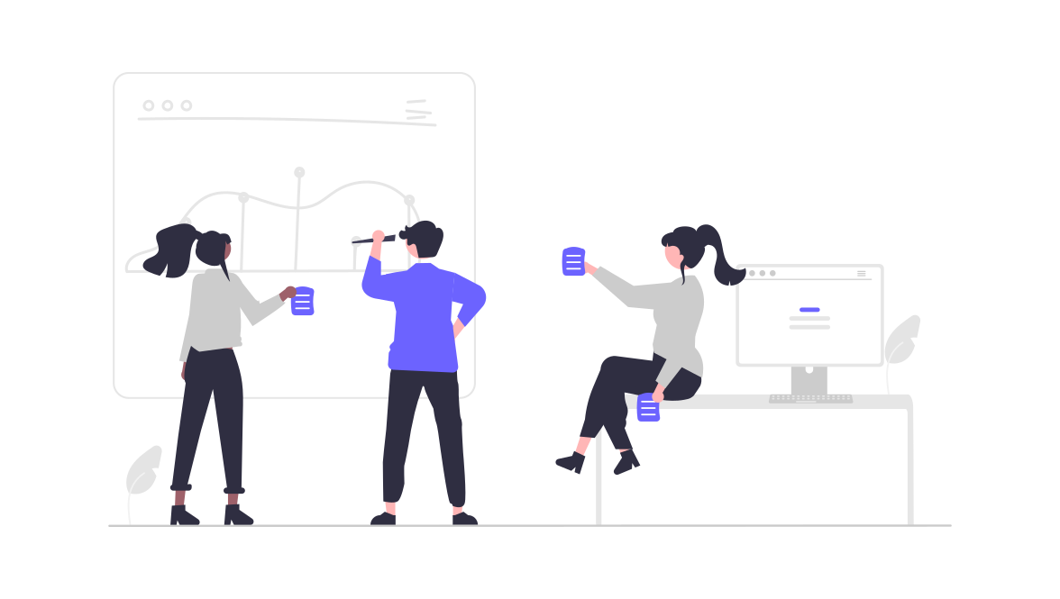
SUPERLATIVE ADJECTIVES
Messi is the most popular soccer player.
Andrea is the happiest person in the class.
My laptop has the biggest screen.

Slide 33
WATCH A VIDEO
Go to iMaster platform and watch a video about the rules of superlative adjectives.
https://youtu.be/JoXpuOJkHkg

Slide 34
EXAMPLES FROM THE VIDEO
Do you remember some examples shown in the video. Complete the chart with some of them.
Long | Longest

Slide 35
GRAMMAR SPOT

Slide 36
ADJECTIVES WITH 1 SYLLABLE
SMALL | THE SMALLEST
BIG
SHORT
HOT
COLD
TALL
FAT
SAD

Slide 37
ADJECTIVES WITH 2 SYLLABLES, ENDING IN Y.
BUSY | THE BUSIEST
HAPPY
DIRTY
NOISY
CRAZY
LAZY
TINY
MESSY

Slide 38
ADJECTIVES WITH 2 OR MORE SYLLABLES
EXPENSIVE | THE MOST EXPENSIVE
IMPORTANT
DANGEROUS
INTELLIGENT
POPULAR
MODERN
BEAUTIFUL
SUCCESSFUL

Slide 39
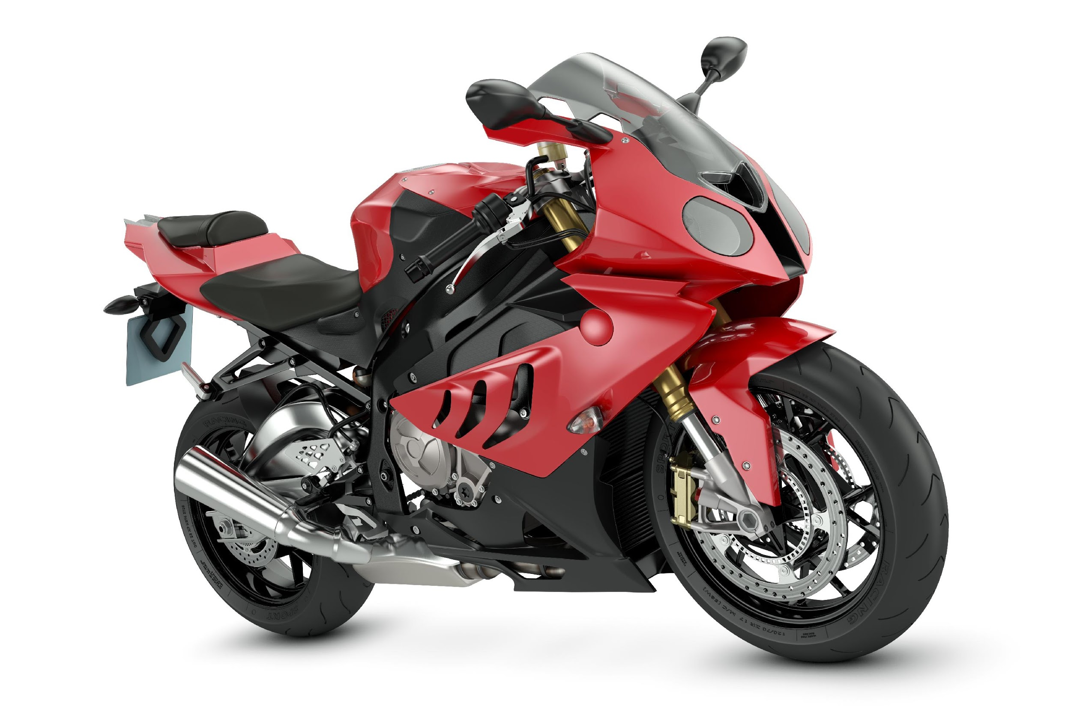
EXAMPLE
Motorcycles are the most dangerous means of transportation.

Slide 40
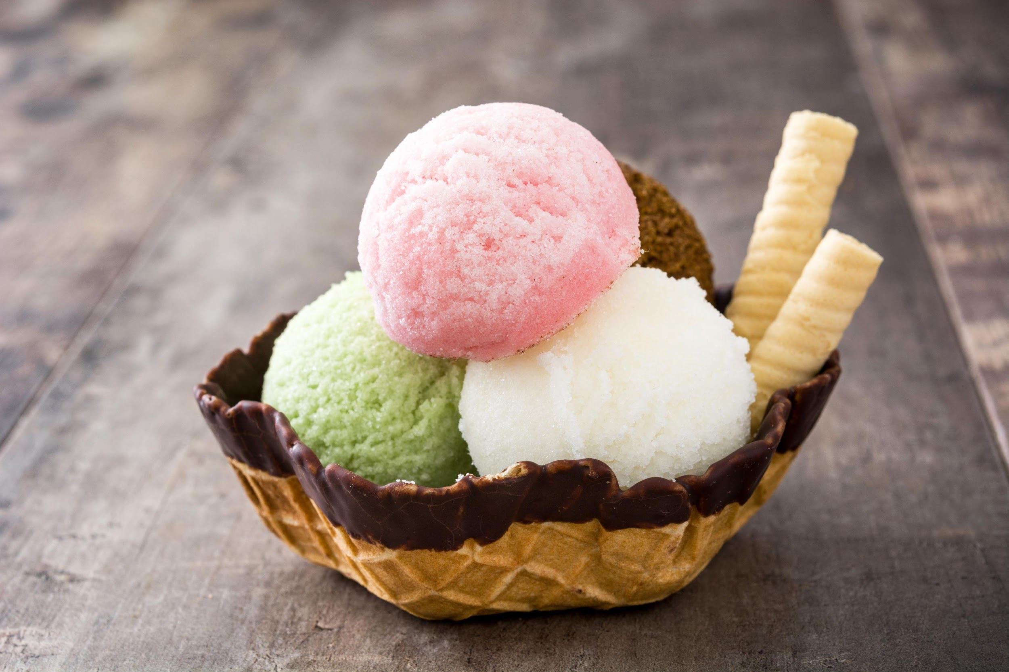
EXAMPLE
Chocolate is the most delicious flavor for ice creams.

Slide 41
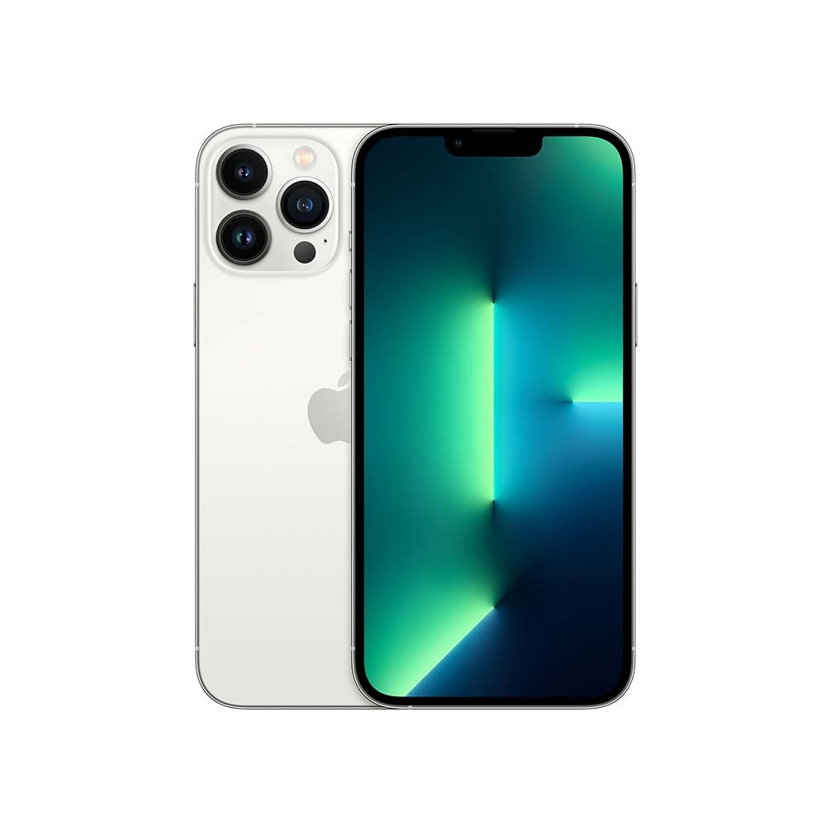
EXAMPLE
iPhone 13 is the newest iPhone.

Slide 42
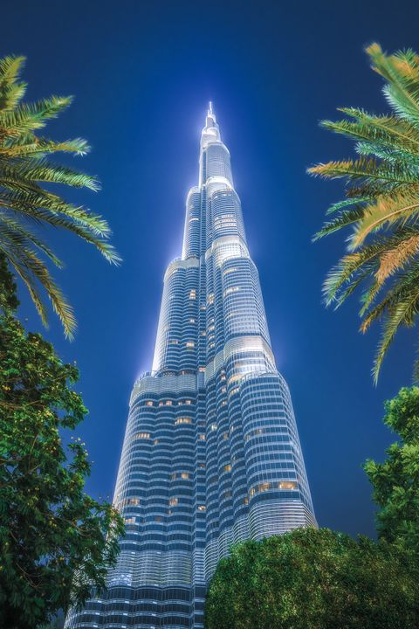
EXAMPLE
Burj Khalifa is the tallest building in the world.

Slide 43
LET’S PLAY
Go to iMaster platform and practice comparatives and superlatives in Quizizz.
https://wordwall.net/es/resource/14303690

Slide 44
LISTENING
Go to iMaster platform and listen to the audio. Then, answer the questions using the superlative structure.
https://www.linguahouse.com/es/esl-lesson-plans/business-english/comparing-brands

Slide 45
LISTENING ACTIVITY
Listen to the next audio. Then, complete the following sentences.
According to the woman… Answer the following questions:
What is the best brand? _____________________________
Which brand is the most expensive? _________________________
Which brand does she think is the worst? _____________________________
Which is the most suitable brand for older people? ________________________
Which brand is the most popular with younger people? _______________________
Apple makes _________ and ________ ___________ laptops
https://www.linguahouse.com/es/esl-lesson-plans/business-english/comparing-brands

Slide 46
LET’S PLAY
Go to iMaster platform and practice superlative adjectives in Wordwall.
https://quizizz.com/admin/quiz/607cd9fbc10a8c001c2e0264

Slide 47
READING
Go to iMaster platform and do the reading activity about: OLD INVENIONS.
https://es.liveworksheets.com/worksheets/en/English_as_a_Second_Language_(ESL)/Past_simple/Old_inventions_reading_comprehension_dg977512kt

