Slide 1
WELCOME UNIT 3

Slide 2
MY OBLIGATIONS AND DUTIES AS A PROGRAMMER
UNIT 3 | CYCLE 2

Slide 3
IN THIS UNIT, YOU WILL LEARN ABOUT:
Modal verbs.
Vocabulary.

Slide 4
LET’S TALK
Go to iMaster and open the random picker wheel and discuss the questions about technology.
https://wordwall.net/es/resource/14985026

Slide 5
MODAL VERBS

Slide 6
HOW MUCH DO YOU KNOW
ABOUT THEM?
CAN
MUST
HAVE TO
Can you give some example?
SHOULD
COULD
MAY

Slide 7
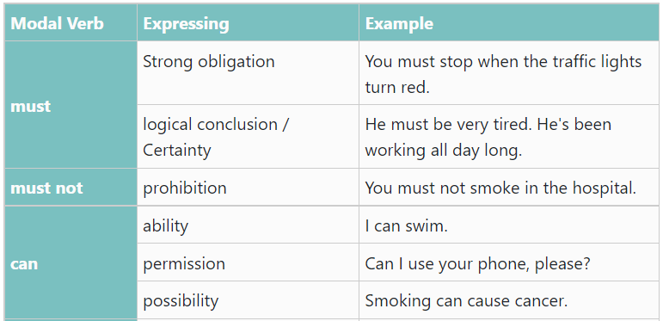
LET’S EXPLORE THEM

Slide 8
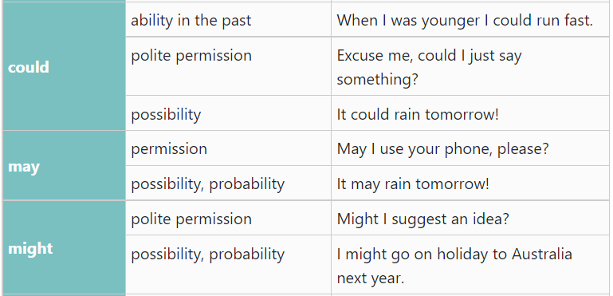
LET’S EXPLORE THEM

Slide 9
LET’S EXPLORE THEM

Slide 10
LET’S PRACTICE
Go to WordWall and practice some modal verbs.
https://wordwall.net/resource/4083108

Slide 11
NEGATIVE FORMS
MUSTN’T
DON’T
HAVE TO
CAN’T
SHOULDN’T
MAY NOT
COULDN’T

Slide 12
LET’S PRACTICE
Go to iMaster platform and open the LiveWorksheet about modals.
https://www.liveworksheets.com/qm550722av

Slide 13
ACTIVITY
Choose the right modal verb: can, can´t, could, couldn`t, must, mustn´t, shouldn`t, should, may, may not, have to, don´t have to. You don´t have to use them all.
There are plenty of tomatoes in the fridge. You _________ buy any.
It's a hospital. You _________ smoke.
He had been working for more than 11 hours. He__________ be tired after such a day. He ___________ prefer to get some rest.
I ___________speak Arabic fluently when I was a child and we lived in Morocco. But after we moved back to Canada, I had very little exposure to the language and forgot almost everything I knew as a child. Now, I _________ just say a few things in the language.
The teacher said we ______ read this book for our own pleasure as it is optional. But we __________ read it if we don't want to.
______you stand on your head for more than a minute? No, I ________.
If you want to learn to speak English fluently, you ____________ to work hard.
You ______________ leave small objects lying around. Such objects ____________ be swallowed by children.
Drivers ________ stop when the traffic lights are red.
______I ask a question? Yes, of course

Slide 14
ACTIVITY
Choose the right modal verb: can, can´t, could, couldn`t, must, mustn´t, shouldn`t, should, may, may not, have to, don´t have to. You don´t have to use them all.
There are plenty of tomatoes in the fridge. You _____________ buy any.
It's a hospital. You _____________ smoke.
He had been working for more than 11 hours. He______________ be tired after such a day. He _______________ prefer to get some rest.
I _______________speak Arabic fluently when I was a child and we lived in Morocco. But after we moved back to Canada, I had very little exposure to the language and forgot almost everything I knew as a child. Now, I _____________ just say a few things in the language.
The teacher said we _______________ read this book for our own pleasure as it is optional. But we ______________ read it if we don't want to.
_____________you stand on your head for more than a minute? No, I _____________.
If you want to learn to speak English fluently, you ______________ to work hard.
You ________________ leave small objects lying around. Such objects _______________ be swallowed by children.
Drivers _______________ stop when the traffic lights are red.
______________I ask a question? Yes, of course
Don’t have
Mustn't
Mustn't
may
could
can
can
Don’t have to
can
Can’t
Have to
Shouldn’t
may
must
may

Slide 15
QUIZ
Go to iMaster platform and do the quiz proposed for this topic.
https://wordwall.net/resource/11084505/modal-verbs

Slide 16
TONGUE
TWISTER

Slide 17
HOW MUCH WOOD COULD A WOODCHUCK CHUCK IF A WOODCHUK COULD CHUCK WOOD?

Slide 18
IF YOU CAN’T CAN ANY CANDY CAN, HOW MANY CANDY CANS CAN A CANDY CANNER CAN IF HE CAN CAN CANDY CANS?

Slide 19
VIDEO
Go to iMaster platform and watch the explanatory video about modal verbs.
https://www.youtube.com/watch?v=o1Fe4QqEkH8

Slide 20
READING
Go to iMaster platform and do the reading about:
8 BITS OF ADVICE FOR NEW PROGRAMMERS

Slide 21
LET’S PRACTICE
Go to iMaster platform and practice modal verbs with a Quizizz activity.
https://quizizz.com/admin/quiz/5841b79993a366fc46b7f960

