Slide 1
WELCOME UNIT 4

Slide 2
ARE YOU GOING TO BE A PROGRAMMER?
UNIT 4 | CYCLE 2

Slide 3
IN THIS UNIT, YOU WILL LEARN ABOUT:
Future plans:
Going to.
Will.

Slide 4
LET’S PLAY
How many words can you construct in only 3 minutes? How much vocabulary do you know? | WORDSHAKE
https://learnenglishteens.britishcouncil.org/vocabulary/vocabulary-games/wordshake

Slide 5
- DO YOU HAVE PLANS FOR THIS WEEK?
-DO YOU HAVE PLANS FOR A MONTH?
LET’S TALK

Slide 6
FUTURE TIME EXPRESSIONS
We are going to have classes next week.
I will buy a new laptop next month.

Slide 7
GOING TO

Slide 8
FUTURE
PLANS

Slide 9
WHAT ARE YOU GOING TO DO THIS WEEK?
go to a party tonight.
I’m going to…
check English classes videos tomorrow.
do some programming tasks I need to do.

Slide 10
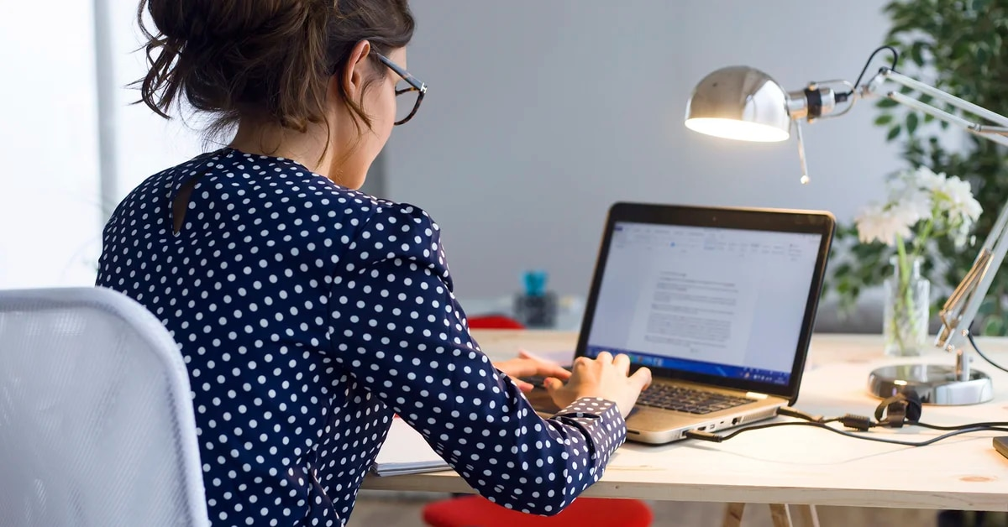
Nathaly is going to start a new C++ Project next week.

Slide 11
We are going to create a Tic Tac Toe game using Python.

Slide 12
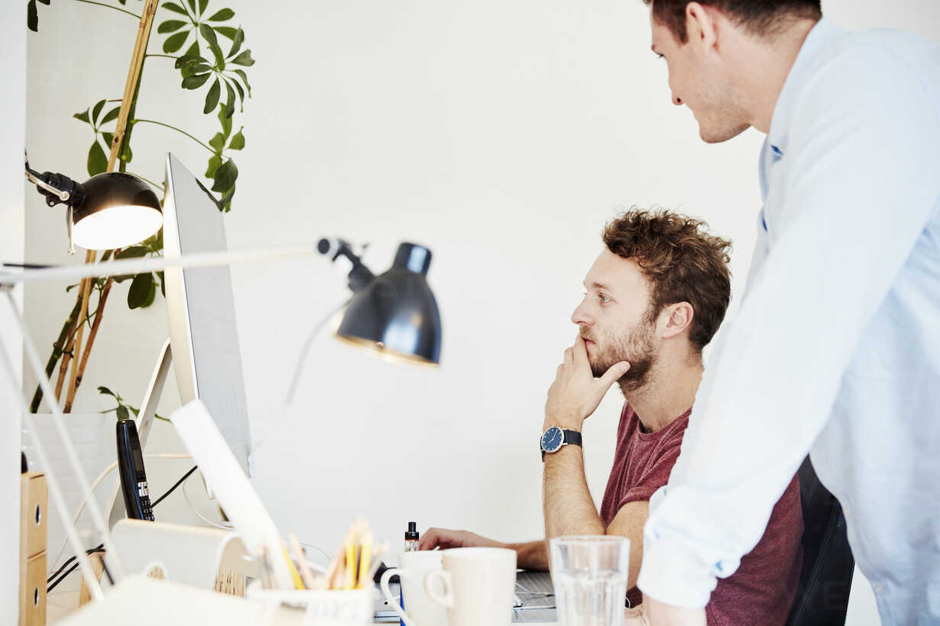
Ronald and Martin are going to create an app for the new clients of the company.

Slide 13
When I finish this course, I’m going to ask for a promotion in my work.

Slide 14
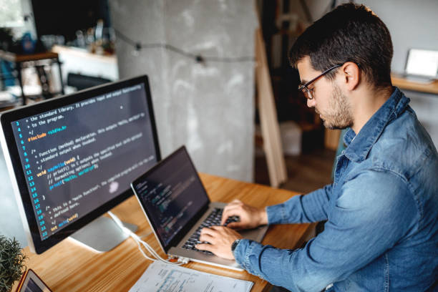
Antonio is taking a programming course; he is going to be the new programmer of the team.

Slide 15
LET’S ANALYZE THE FOLLOWING EXAMPLE

Slide 16
THESE ARE JULIETH’S PLAN FOR THE WEEK.
Buy a new Mac in iShop on Monday.
Work at the office the whole week.
Make a back up of old laptop on Tuesday.
Attend phone calls.
Have a meeting with new colleagues on Friday.

Slide 17
WHAT IS JULIETH GOING TO DO NEXT WEEK?
She is going to buy a new Mac.
She isn’t going to work at her office the whole week.
She isn’t going to attend phone calls during her working hours.
She is going to have a meeting with new colleagues on Friday.

Slide 18
LET’S SEE SOME QUESTIONS ABOUT JULIETH’S PLANS

Slide 19
QUESTIONS
Where is Julieth going to buy the Mac?
What is Julieth going to do on Tuesday?
When is she going to have the meeting?

Slide 20
LET’S PLAY
Let’s challenge your knowledge in Quizizz.
https://quizizz.com/admin/quiz/5f2227c684aa28001b07dce5

Slide 21
PREDICTIONS

Slide 22
PREDICTIONS
Evidence: my computer is slowly.
Prediction: I’m not going to finish my work on time.

Slide 23
PREDICTIONS
Evidence: Jhon’s computer is running out of storage.
Prediction: He’s going to buy storage online.

Slide 24
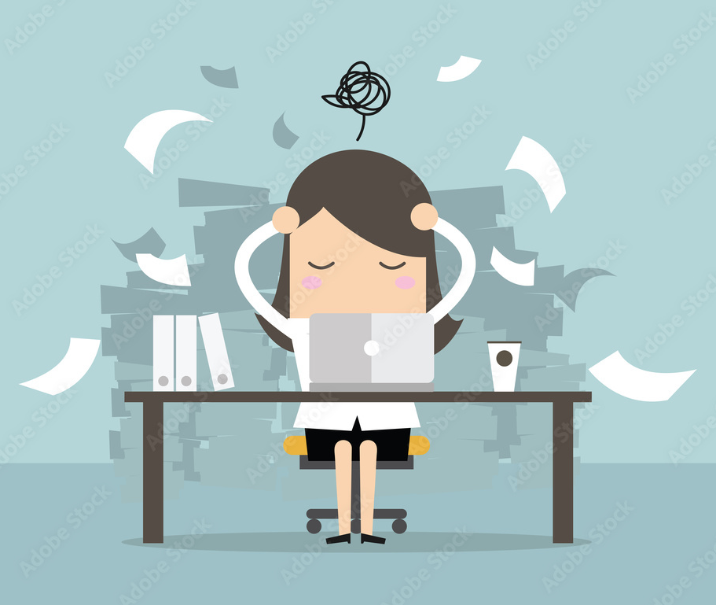
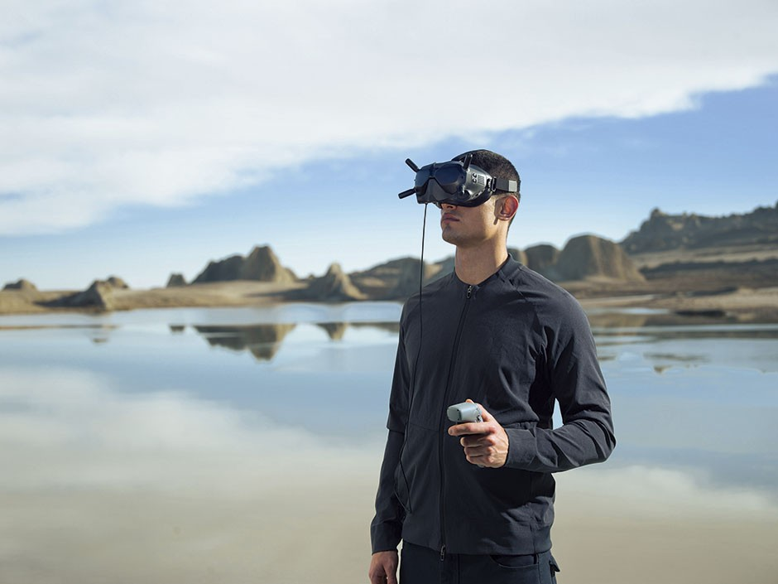
THINK FOR PREDICTIONS TO THE FOLLOWING EVENTS
Weak internet
connection.
A lot of work.
New gadget.

Slide 25
GRAMMAR SPOT

Slide 26
GOING TO
AFFIRMATIVE
SUBJECT | TO BE | GOING TO | VERB | COMPLEMENT
I | am | going to | travel | to Medellin.
You | are
He She It | is
We | are
They
CONTRACTED FORM
I’m
You’re
He’s She’s It’s
We’re
They’re
PLANS
INTENTIONS
PREDICTIONS BASED ON EVIDENCES

Slide 27
GOING TO
NEGATIVE
PLANS
SUBJECT | TO BE | CONTRACTION | GOING TO | COMPLEMENT
I | am not | I’m not | going to | have a meeting.
You | are not | aren’t
He She It | is not | isn’t
We | are not | aren’t
They
INTENTIONS
PREDICTIONS BASED ON EVIDENCES

Slide 28
GOING TO
INTERROGATIVE
PLANS
TO BE | SUBJECT | GOING TO | COMPLEMENT | QUESTION MARK
am | I | going to | to work | ?
are | You
is | he she it
are | we
 | they
INTENTIONS
PREDICTIONS BASED ON EVIDENCES

Slide 29
WH WORDS

Slide 30
WH WORDS
WHERE
WHY
WHAT
HOW
WHO
WHEN

Slide 31
WH QUESTIONS
They are used to give an appropriate information rather than to answer “yes” or “no”.
WH | EXAMPLE
What | What are you going to tomorrow?
Where | Where are they going to travel?
When | When are they going to arrive?
Who | Who is going to be your colleague?
Why | Why are you going to delete the code?
How | How are you going to go to approve the exam?

Slide 32
WH QUESTION STRUCTURE
What are you going to do tonight?
WH + verb to be + subject + GOING TO + verb + complement + ?

Slide 33
LET’S PRACTICE
Go to the platform and do the matching activity about predictions.

Slide 34
READING
Go to the platform and do the Reading activity:
WHAT DOES CLOUD MEETING MEAN?

Slide 35
WILL

Slide 36
SOMEONE IS KNOCKING AT THE DOOR…
I WILL OPEN IT.

Slide 37
MY CODE IS NOT WORKING, BUT THE COMPILER DOESN’T SHOW ME ANY ERROR.
I WILL DEBUG IT.

Slide 38
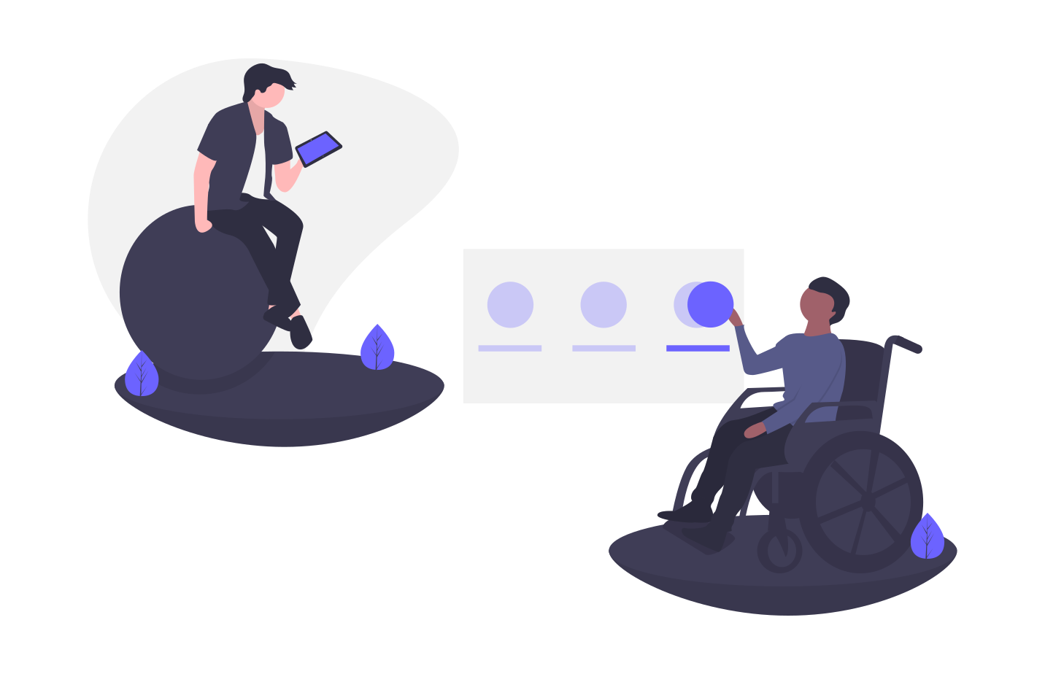
PETER: I HAVE JUST CREATED A GAME ON PYTHON, I NEED SOMEONE TO TEST IT.
GEORGE: I WILL DO IT.

Slide 39
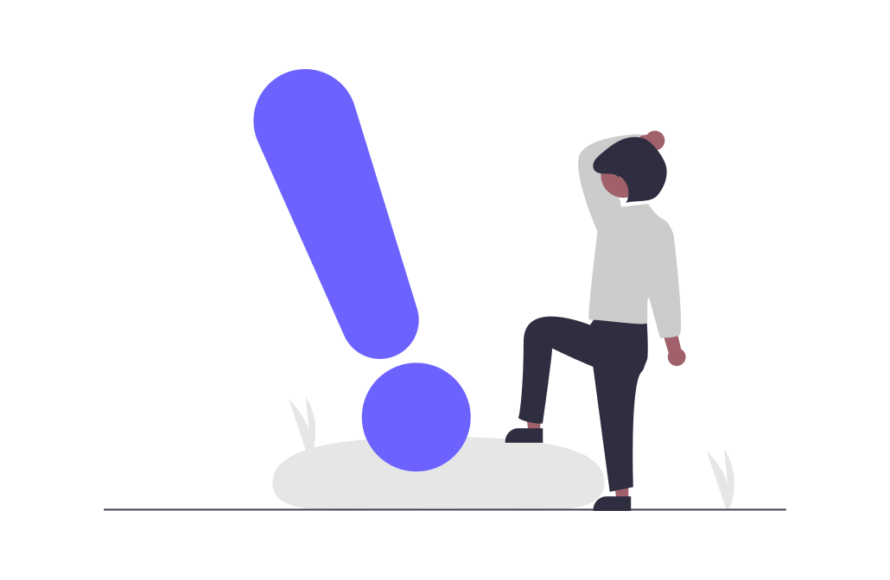
I WILL NOT HELP YOU. IT’S TOO LATE.
I WON’T HELP YOU. IT’S TOO LATE.

Slide 40
THINK SHE WON’T FINISH THE APP FOR NEXT WEEK.

Slide 41
LET’S PRACTICE
Go to the platform and practice this topic with a WordWall activity.
https://wordwall.net/es/resource/2849891

Slide 42
GRAMMAR SPOT

Slide 43
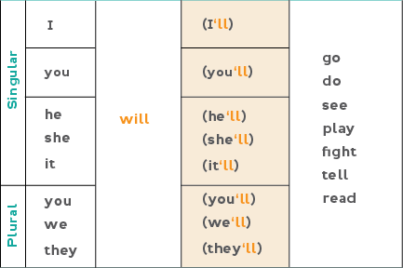
WILL
AFFIRMATIVE
PROMISES AND OFFERS
PREDICTIONS BASED ON WHAT WE THINK
QUICK DECISIONS
BELIEFS ABOUT THE FUTURE

Slide 44
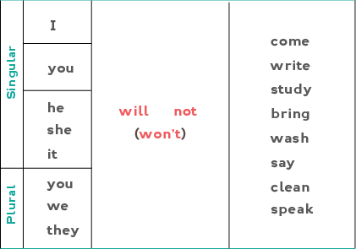
WILL
NEGATIVE
PROMISES AND OFFERS
PREDICTIONS BASED ON WHAT WE THINK
QUICK DECISIONS
BELIEFS ABOUT THE FUTURE

Slide 45
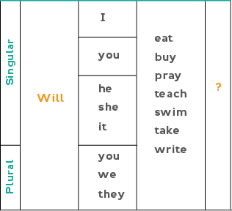
WILL
INTERROGATIVE
PROMISES AND OFFERS
PREDICTIONS BASED ON WHAT WE THINK
QUICK DECISIONS
BELIEFS ABOUT THE FUTURE

Slide 46
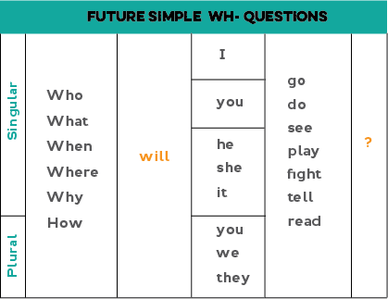
WH QUESTIONS
They are used to give an appropriate information rather than to answer “yes” or “no”.

Slide 47
VIDEO
Go to the platform and watch the video about THE WORLD IN 2050. Then, go to Nearpod and in the collaborative board post your predictions for the future.
https://www.youtube.com/watch?v=ABrjdyavqkI

Slide 48
READING
Go to the platform and do the Reading activity:
ROBOTS

Slide 49
LET’S PRACTICE!
Go to the platform and in LiveWorksheets do the activity proposed.
https://es.liveworksheets.com/worksheets/en/English_as_a_Second_Language_(ESL)/Future_-_will/Future_simple._will_ns601964ax

Slide 50
ACTIVITY
Complete the sentences using will or be going to.
Daniel is creating an app for his company; he is planning his week at work.
He ______________ start coding next Monday according to his schedule.
Martha says, she _______________ help him with some tasks. She _______________ coordinate with his team the test to plan to apply to the app, while Roberto _______________ have a meeting with a potential client on Wednesday to offer the new application.

Slide 51
ACTIVITY
Complete the sentences using will or be going to.
1. If Mary helps me __________ (finish) on time.
2. Steve and his family __________ (travel) to Santa Marta next month.
3. My car is really dirty. I __________(wash) it!.
4. Jessica’s daughter __________ (be) six on Saturday, I __________ (take) my baby to her party.
5. It’s very hot in here. I __________ (open) the window.
6. I __________ (go) to the party unless it rains.
7. I have a special plan for the weekend. I __________ (learn) how to make a cake.

Slide 52
LET’S PRACTICE!
Go to the platform and open Baamboozle to practice the topics learnt in this session.
https://www.baamboozle.com/game/21224

Slide 53
WRITING
Go to the platform and in the forum answer the following questions:
- How do you see yourself in 10 years as a programmer?
- What are your plans?

