Slide 1

WELCOME UNIT 5

Slide 2

PROGRAMMING OR NOT TO PROGRAM?
UNIT 5 | CYCLE 2

Slide 3

IN THIS UNIT, YOU WILL LEARN ABOUT:
Gerunds and infinitives.
Adjectives and adverbs.
Comparison in adverbs.

Slide 4
LET’S TALK
Let’s talk about likes, dislikes and generalities.
https://wordwall.net/resource/495157

Slide 5
GERUNDS AND INFINITIVES

Slide 6
GERUNDS - ING (ACTIONS)
imagine
He enjoys studying programming.
She finished doing all the activities.
I quit smoking because it’s not good for my health.
enjoy
don’t mind
finish
quit
try
practice

Slide 7


GERUNDS - ING (SUBJECTS)
Studying programming is very easy for me.
Doing exercise can help to release stress.
Reading helps you learn English.

Slide 8
INFINITIVES - TO (ACTIONS)
want
decide
learn
hope
plan
would like
Jose wants to learn software development.
I would like to design my first web application.
Maria learned to create a basic program in Python.

Slide 9

INFINITIVES - TO (SUBJECTS)
Use an infinitive as a subject.
- To learn a new language is very important.
- To hack is not good.
- To exercise helps to prevent heart problems.

Slide 10
EXCEPTIONS

Slide 11

LIKE
HATE
LOVE
PREFER
I like to eat pizza : infinitive. I like eating pizza : gerund
She prefers to study at night. She prefers studying at night.

Slide 12
LET’S PRACTICE
Analyze the following text and classify the verbs into gerunds or infinitives.

Slide 13
ACTIVITY
Do you enjoy programming? Are you learning to program with Python, Java Script, C++? Do you want to become a programmer? If your answer is “yes” and you’d like to turn your dream into reality, come to MISION TIC 2022. At MISION TIC 2021 you can practice programming with other young people like you. We love helping talented young people achieve their ambitions. The official mission is “To inspire people to rock on stage and in life.” If you live in Colombia, are between 18 and 60, and hope to be a programmer, call us now!

Slide 14
ACTIVITY
classify the verbs from the text into gerunds or infinitives.
GERUNDS | INFINITIVES

Slide 15
LET’S PLAY!
Challenge your understanding about this topic in Kahoot.
https://create.kahoot.it/share/gerunds-and-infinitives/cae72393-505f-440b-b171-a248df78b4e2

Slide 16
ADJECTIVES AND ADVERBS

Slide 17
ADJECTIVES
Good
Slow
Careful
Successful
Bad
Loud
Fast
Calm
Stressful
Angry
Word that describes a noun or pronoun: person, place, thing, idea.

Slide 18

REGULAR ADVERBS | IRREGULAR ADVERBS
Slowly | Often
Stressfully | Fast
Carefully | Well
Regularly | badly
Efficiently
Loudly

Slide 19
LET’S PRACTICE
Complete the chart with the correct adverb or adjective that is missing.

Slide 20
ACTIVITY
ADJECTIVES | ADVERBS
 | Extremely
Fair
Fast
 | Camly
Careful
 | Incredibly
Terrible
 | slowly
quick
successful

Slide 21
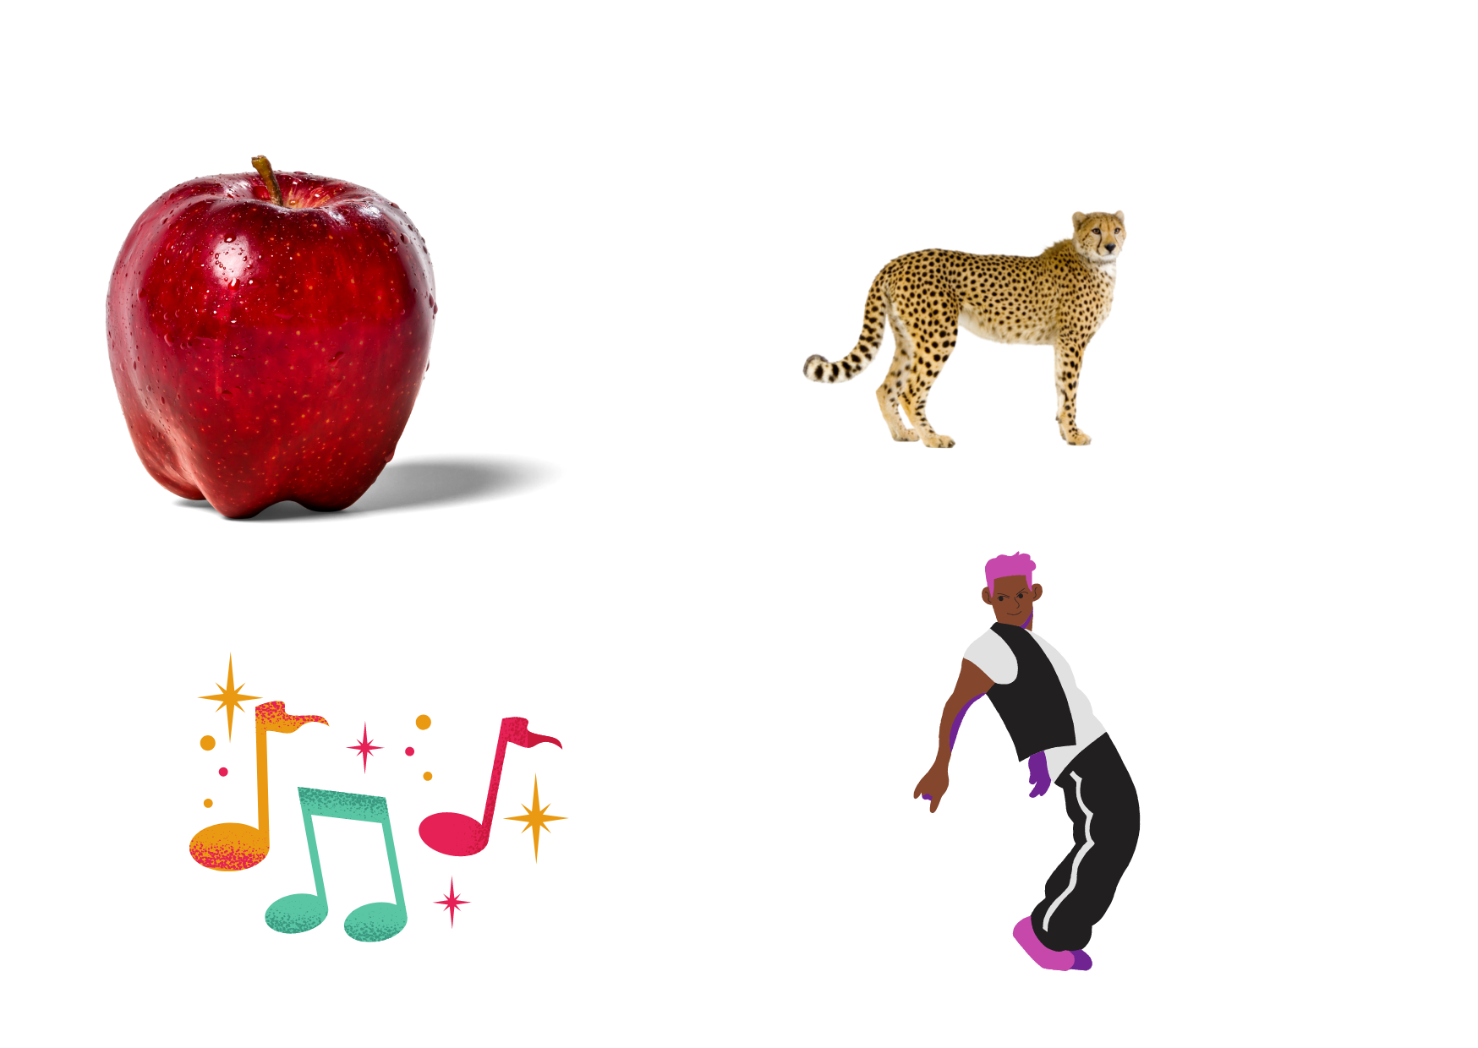
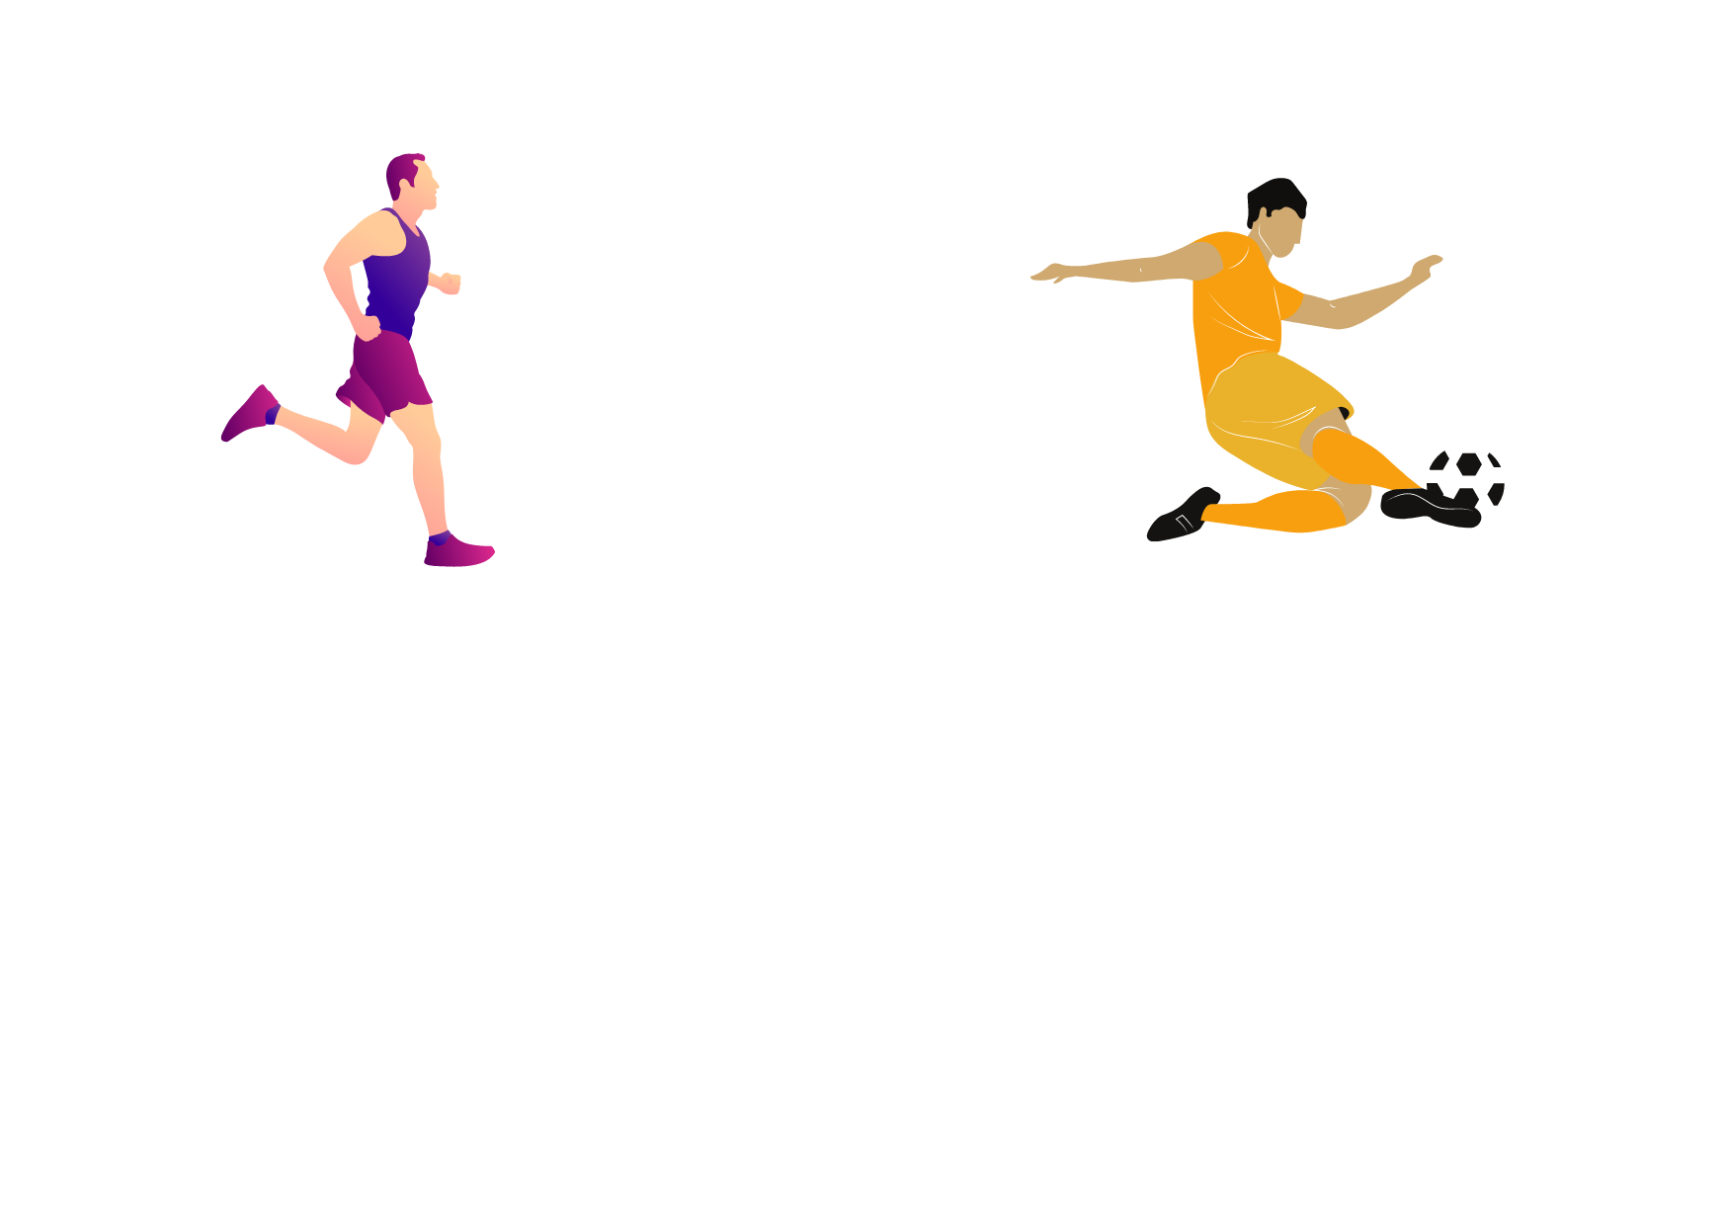
ADJECTIVES | ADVERBS
This apple is bad.
A cheetah is quick.
This music is good.
He dances badly.
She runs quickly.
He plays football well.

Slide 22
LET’S PRACTICE
Use adjectives or adverbs for answering the following questions.

Slide 23

HOW DO YOU PROGRAMME?

Slide 24

HOW DO YOU DANCE?

Slide 25
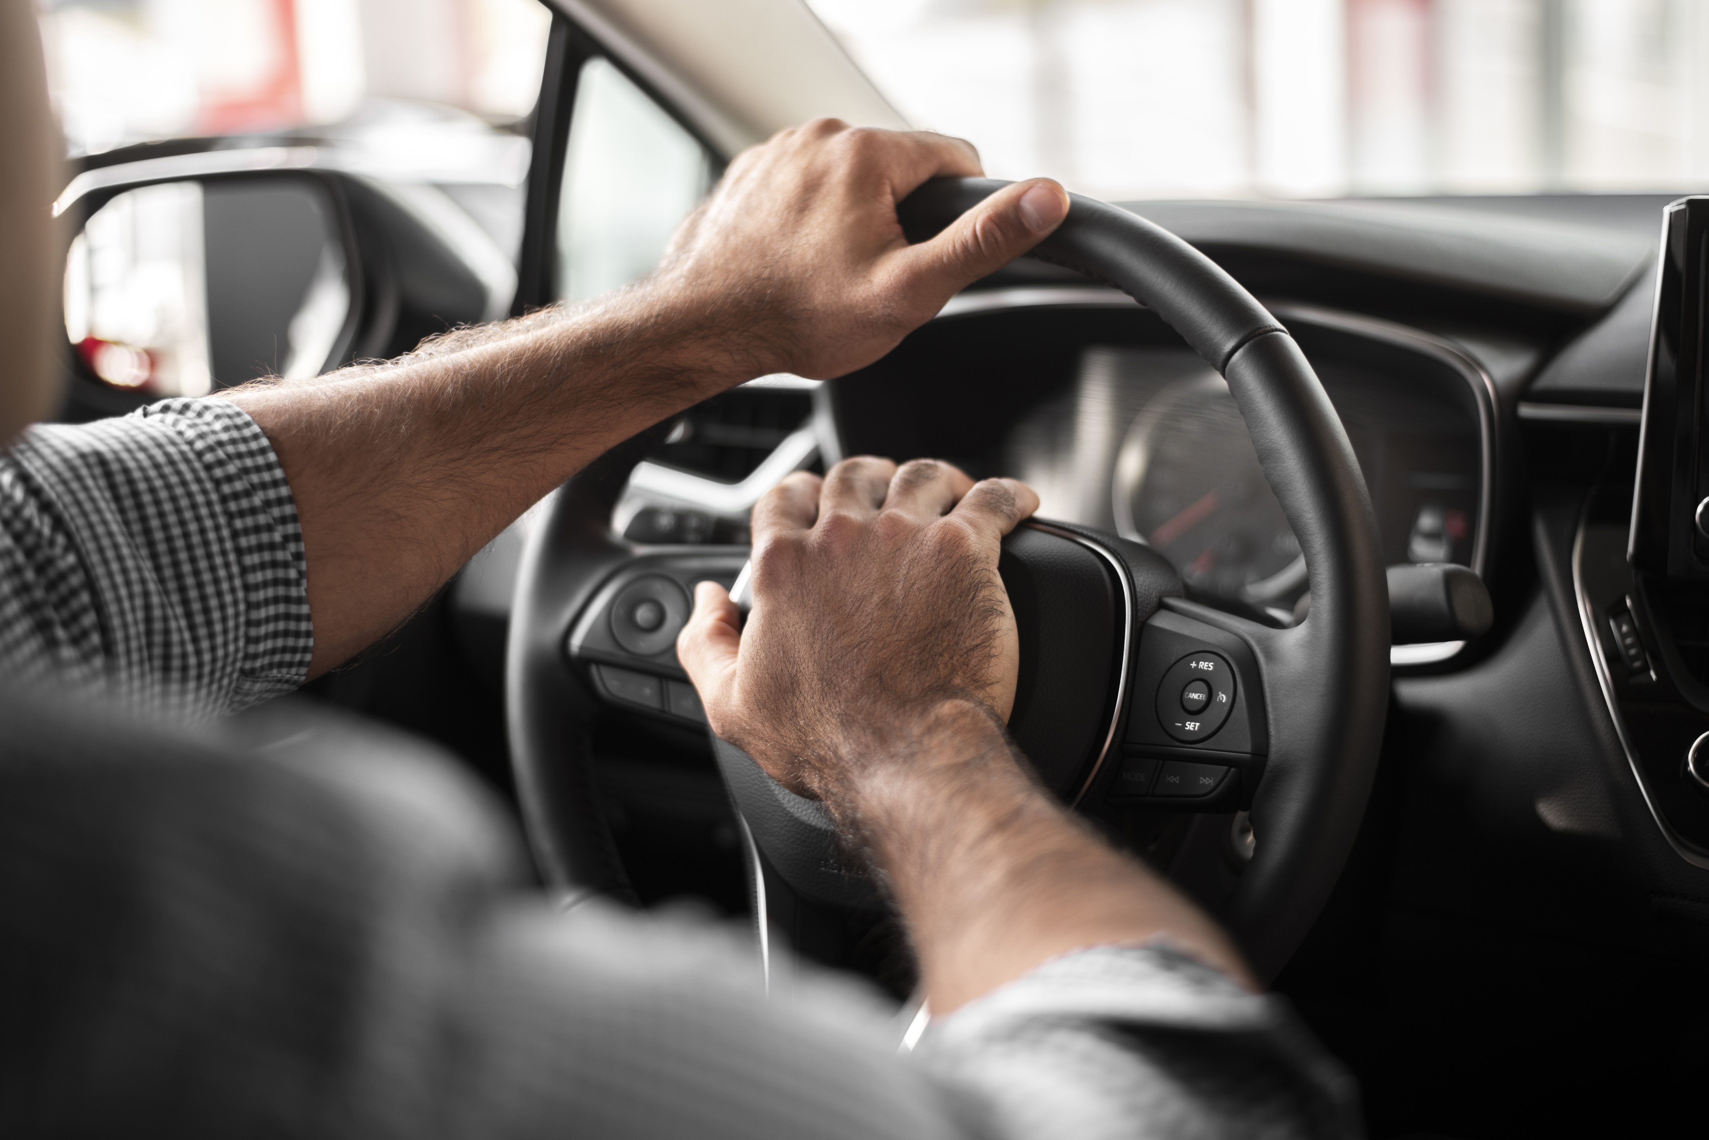
HOW DO YOU DRIVE A CAR?

Slide 26

HOW DO YOU SPEAK?

Slide 27
LET’S PLAY!
Go to the platform and open the WordWall activity.
https://wordwall.net/es/resource/24489784

Slide 28
LET’S PRACTICE
Choose the correct adjective or adverb to complete the sentences.

Slide 29

ACTIVITY
slowly
loudly
successful
quickly
good
slow
My brother creates programs so _______.
She likes to be a _______ person and help other.
Juan always walks ________. He is ______.
He wants to be a ________ programmer.
I speak_________ at any place.

Slide 30
ACTIVITY
slowly
loudly
successful
quickly
good
slow
My brother creates programs so _quicly__.
She likes to be a _good__ person and help other.
Juan always walks _slowly__. He is _slow_____.
He wants to be a _successful__ programmer.
I speak_loudly___ at any place.

Slide 31
LET’S PLAY!
Go to the platform and open the WordWall activity.
https://wordwall.net/es/resource/27434116

Slide 32
LET’S PLAY!!
Go to the platform and practice the topic in Baamboozle.
https://www.baamboozle.com/game/1905

Slide 33
COMPARISON IN ADVERBS

Slide 34

I can create programs more quickly than my friend Marcos.
I programme the most quickly of you all.

Slide 35

I organize my files more often than my sister.
I can design applications the best of all.

Slide 36
ACTIVITY
Complete the chart with the correct comparative and superlative form.
REGULAR ADVERBS | COMPARATIVE | SUPERLATIVE
Slowly
Stressfully
Carefully
Regularly
Efficiently
Quickly
Calmly

Slide 37
ACTIVITY
Complete the chart with the correct comparative and superlative form.
IRREGULAR ADVERBS | COMPARATIVE | SUPERLATIVE
Often
Fast
Well
badly

Slide 38
LET’S PRACTICE!
Go to the platform and solve the Liveworksheet activity.
https://www.liveworksheets.com/worksheets/en/English_as_a_Second_Language_(ESL)/Comparative_and_superlative_adverbs/Comparison_with_adverbs_yf1932926mq

Slide 39
READING
Read the following text. Then, choose the best option for each statement.

Slide 40
READING
WE CAN HELP!
Studies show that people who live the least stressfully …
organize their files the most carefully, clean their houses the most often,work in their backyards the most regularly.Do you want to have a more peaceful,less stressful life, and work or study faster and more efficiently? Then clean up and organize your living space more regularly! We can help you get started! We promise that after our visit, you will be better organized and you will have to clean up less often than before!

Slide 41
READING
1. Study shows that people who live least stressfully….
organize the most carefully and clean their houses the most often.
doesn’t organize and clean their house the most often.
2. According to the text, the step to have a least stressful life are…
Organize, clean and work in the backyard regularly.
Organize, clean and study efficiently.
3. If you want to have a more peaceful life....
You have to study and work harder
You have to clean up and organize your living space more regularly!
4. The text is about…
Tips to have a better life.
Recommendations to study more.

Slide 42
READING
1. Study shows that people who live least stressfully….
organize the most carefully and clean their houses the most often.
doesn’t organize and clean their house the most often.
2. According to the text, the step to have a least stressful life are…
Organize, clean and work in the backyard regularly.
Organize, clean and study efficiently.
3. If you want to have a more peaceful life....
You have to study and work harder
You have to clean up and organize your living space more regularly!
4. The text is about…
Tips to have a better life.
Recommendations to study more.

Slide 43
READING
Go to the platform and read the article about:
HEDY LAMARR
Do you know who it was?
Do you know people who have been vital in the development of technology?

