Slide 1
WELCOME UNIT 6

Slide 2
READING STRATEGIES TO BECOME A FLUENT READER
UNIT 6 | CYCLE 2

Slide 3
IN THIS UNIT, YOU WILL LEARN ABOUT:
Cognates.
Synonyms and antonyms.
Sentence connectors.

Slide 4
OBSERVE THE FOLLOWING IMAGES AND ANSWER THE QUESTIONS:
- What do you think about the message?
- Is it correct or incorrect? Why?
- Are there other ways to express the intended message?

Slide 5
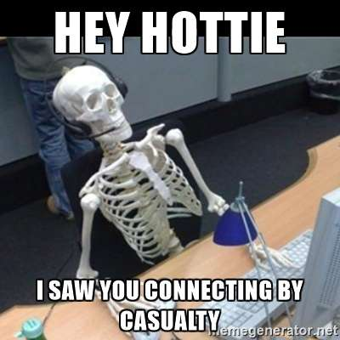
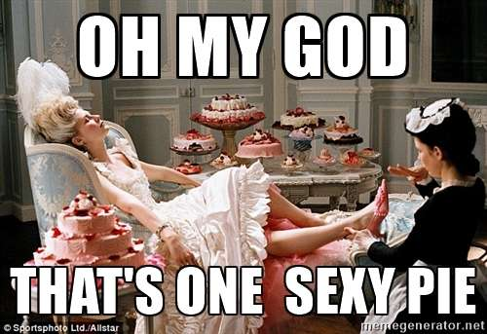
Casualty: a person injured or killed in a serious accident or war. Victim
Pie: a type of food made with meat, vegetables, or fruit.

Slide 6
COGNATES
TRUE | FALSE | PARTIAL

Slide 7
WHAT ARE COGNATES?
Hockey
A cognate is a word that comes from the same origin as a word from a different language.
Criminal
Dentist
Capital
Decision
Control
Base

Slide 8
WHAT ARE COGNATES?
Chocolate
International
English and Spanish are closely related (both have Latin roots) some words in Spanish are similar in form and meaning to a Word in English.
Family
Internacional
Chocolate
Familia

Slide 9
WHAT ARE COGNATES?
Cognates between languages usually have similarities in spelling, pronunciation, and meaning.
Confusion
Confusión
Drama
Drama
Explosion
Explosión

Slide 10
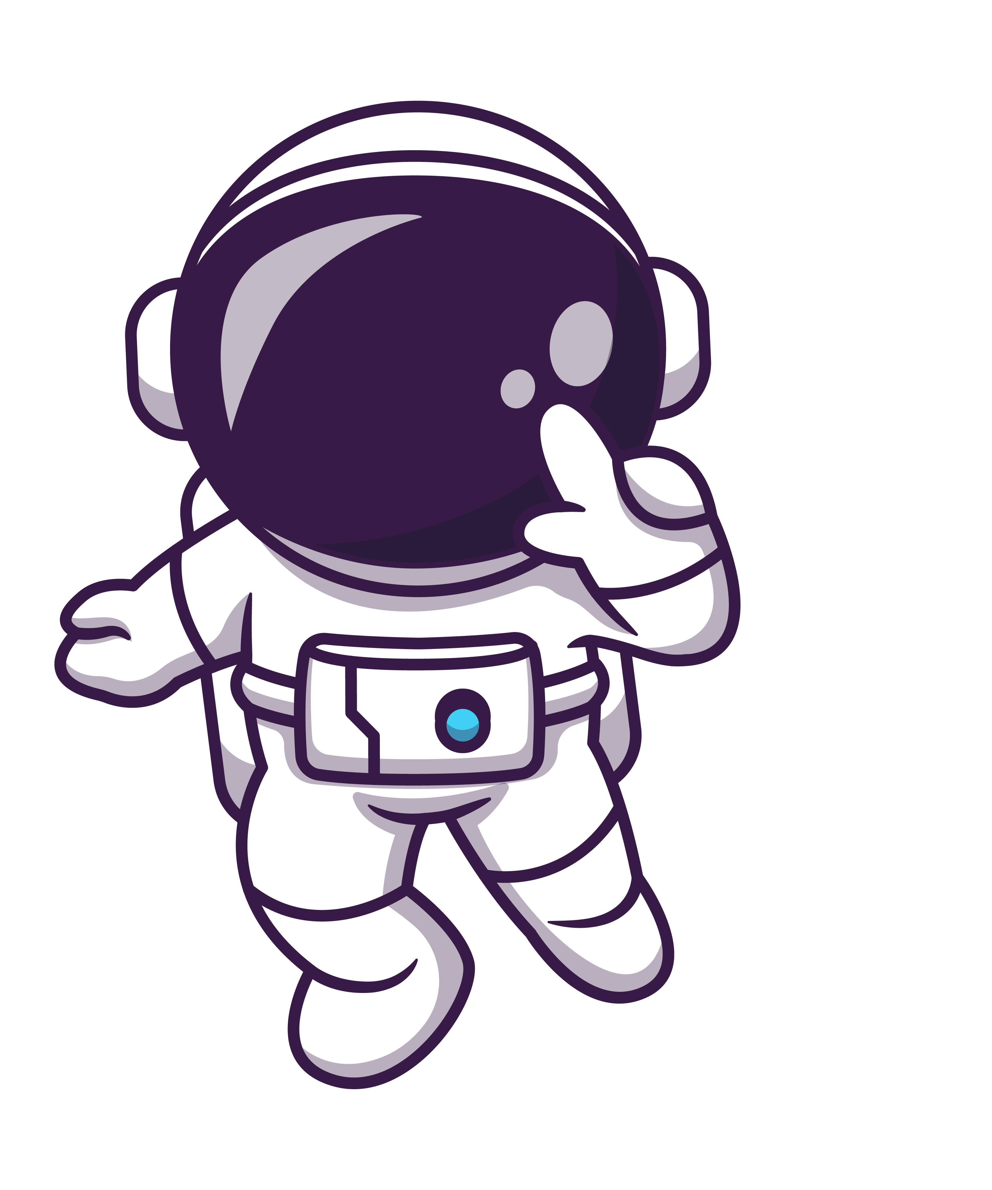
WHAT ARE COGNATES?
This means that someone who speaks English and knows the word ''doctor'' would be able to understand the meaning of the French word ''docteur'' even if they're completely unfamiliar with French.
For example:

Slide 11
TRUE COGNATES
They have a similar spelling and sound in English and Spanish.
Familia
Family

Slide 12
ACTIVITY
Instruction: match the following word with its correspondent true cognate.
SPANISH | ENGLISH
Hockey
Diccionario
Elefante
Parcial
Familia
Teléfono
Accidente
Falso
Mapa
Tomate
Map
Elephant
Family
False
Tomato
Partial
Dictionary
Hockey
Telephone
Accident

Slide 13
ACTIVITY
Instruction: match the following word with its correspondent true cognate.
SPANISH | ENGLISH
Hockey
Diccionario
Elefante
Parcial
Familia
Teléfono
Accidente
Falso
Mapa
Tomate
Hockey
Dictionary
Elephant
Partial
Family
Telephone
Accident
False
Map
Tomato

Slide 14
FALSE COGNATES
Words that are alike in English and Spanish but have a different meaning.

Slide 15
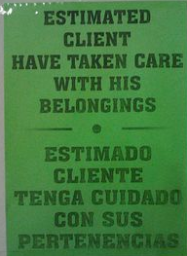
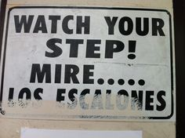
OBSERVE THE FOLLOWING IMAGES AND TRY TO IDENTIFY THE FALSE COGNATE.

Slide 16
EXAMPLE
ENGLISH WORD
FALSE COGNATE
REAL MEANING
Pie
Pie
Foot
Exit
Éxito
Success
Actual
Actual
Current
Figures
Figuras
Cifras
Pregnant
Embarrassed
Embarazada
Library
Librería
Biblioteca
Fabric
Fabrica
Factory

Slide 17
ACTIVITY
Instruction: complete each sentence with the correct false cognate.
1. Do you know that Sarah got ____________ (embarrassed/pregnant) on holiday in San Andres Island?
2. The ____________ (signature/subject) I hate the most is programming.
3. How many _____________ (idioms/languages) can you speak?
4. ____________ (Actually/nowadays) I live with my parents.
5. The police came to my ____________ (assistance/attendance).

Slide 18
ACTIVITY
Instruction: complete each sentence with the correct false cognate.
pregnant
1. Do you know that Sarah got ____________ (embarrassed/pregnant) on holiday in San Andres Island?
subject
2. The ____________ (signature/subject) I hate the most is programming.
languages
3. How many _____________ (idioms/languages) can you speak?
Nowadays
4. ____________ (Actually/nowadays) I live with my parents.
assistance
5. The police came to my ____________ (assistance/attendance).

Slide 19
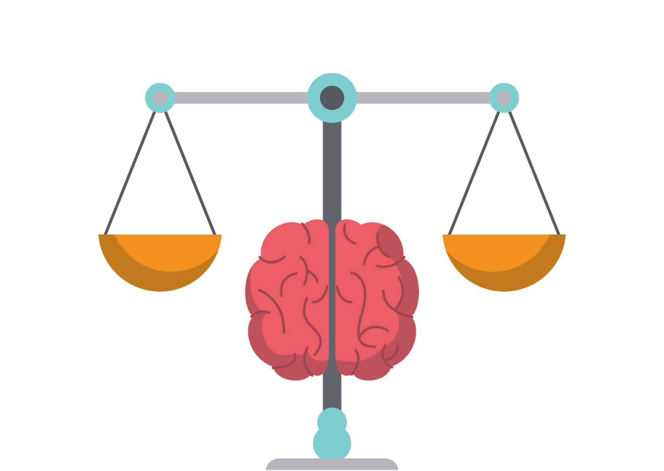
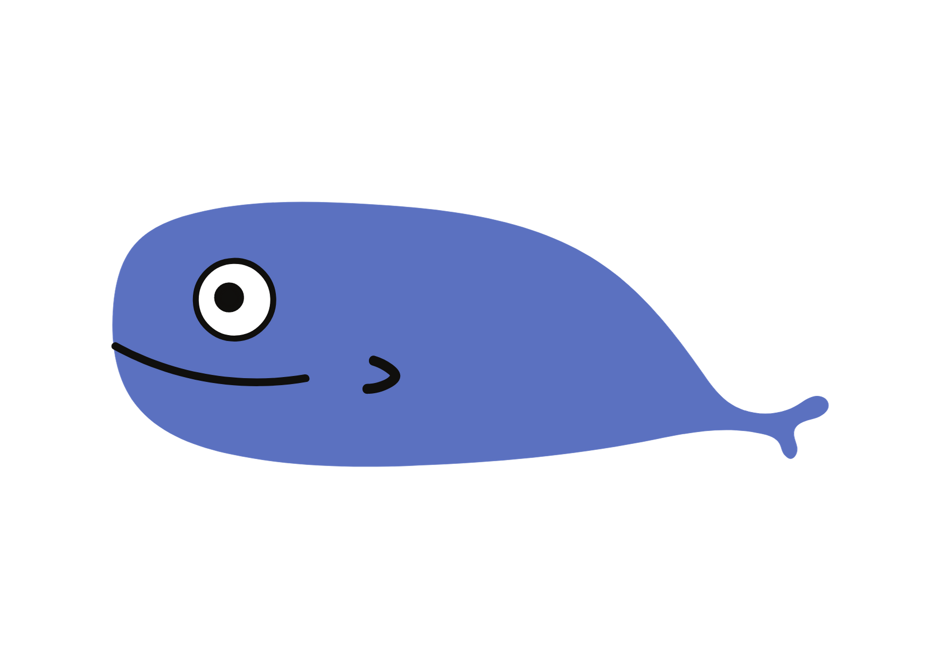
SENSIBLE
Sensible (sensitive).
To do something with good judgement.
CONSTIPATED
Constipado (to have a cold).
Can’t poop.
COMPROMISE
Compromiso (a commitment).
When two people both change their ideas to settle an argument.
LARGE
Largo (long).
Very big.

Slide 20
PARTIAL COGNATES
Words that have the same meaning in both languages in some, but not all context.
Familiar
Familiar

Slide 21
EXAMPLE
Associated with the people you are most likely to be closest: family.
FAMILIAR
FAMILIAR
Conocido (known) or (common).
INTRODUCIR
INTRODUCE
As a verb “to introduce”. It means so in the sense you are putting a law or policy into effect.
“Presentar” when introducing people.
MISERIA
MISERY
It refers to be in a miserable situation, not simply feeling miserable.
Great unhappy (tristeza, pena).

Slide 22
ACTIVITY
Instruction: match each word with the two-corresponding meaning.
It can be used to refer to a family member.
Colegio
College
Large, flat area surrounded by seats used for sports.
Relativo
Relative
Substance that consist of very small grains of rock.
It refers to the school in general.
Arena
Arena
It means “related to”.
Institute of higher education.

Slide 23
ACTIVITY
Instruction: match each word with the two-corresponding meaning.
It can be used to refer to a family member.
Colegio
College
Large, flat area surrounded by seats used for sports.
Relativo
Relative
Substance that consist of very small grains of rock.
It refers to the school in general.
Arena
Arena
It means “related to”.
Institute of higher education.

Slide 24
LET’S PRACTICE!
Go to iMaster platform and do the activity about true, false, and partial cognates.

Slide 25
LET’S TALK!
- Could machines/robots totally replace human beings in the future?
- What do you think about the future of the digital world? Economy, environment, society, jobs, travel, religion, health, etc.

Slide 26
READING
Go to the platform and do the reading activity about “WHAT IS THE FUTURE OF THE DIGITAL WORLD?”.

Slide 27
HOW STRONG IS
YOUR VOCABULARY?
Do you know a similar meaning?
Do you know an opposite word?

Slide 28
SIMILAR MEANING
OPPOSITE MEANING
HOUSE
SAD
GOOD
SMART
ANGRY
WATCH

Slide 29
SYNONYMS AND ANTONYMS
SYNONYM | ANTONYM | RELATIONAL ANTONYM

Slide 30
WHAT ARE SYNONYMS?
Words that are similar, or have a related meaning, to another word. They can be lifesavers when you want to avoid repeating the same word over and over.

Slide 31
EXAMPLE
Nice
Friendly
Amiable
KIND
Generous
Caring
Gentle
Sympathetic

Slide 32
WHAT ARE ANTONYMS?
Words with opposite meaning.

Slide 33
EXAMPLE
Fierce
CALM
Furious
Harsh
Blustering
Choppy
Wild
Immoderate

Slide 34
WHAT IS RELATIONAL ANTONYM?
Pairs of words that indicate a reciprocal social relationship.
TEACHER
STUDENT

Slide 35
EXAMPLE
Buy
Sell
Push
Pull
Exit
Entrance
Doctor
Patient
Predator
Prey
Teach
Learn
Husband
Wife
Come
Go

Slide 36
LET’S TALK!
Do you use a computer everyday?
What do you use a computer for mostly?
Do you have any special brand? Why?
What was the first time you used a computer?
What are the advantages and disadvantages of using computers?

Slide 37
READING
Go to the platform and do the reading activity about “COMPUTERS”.

Slide 38
SENTENCE CONNECTORS
Sentence connectors are used to link ideas from one sentence to the next and to give paragraphs coherence.
They are also called linking words.

Slide 39
SENTENCE CONNECTORS
Order of importance
Reason
Logical / sequential order
Comparison
Contrast
Result
They perform different functions.
They are placed at the beginning of a sentence and some in the middle of a sentence

Slide 40
USEFUL SENTENCE CONECTORS
OPINION | SEQUENCE | ADDITION | EMPHASIS | CONTRAST
I think I believe I feel In my opinión In my view | Firstly Secondly Then Next afterwards | And Also In addition Further Furthermore | Above all Especially More importantly Indeed Significantly | However Nevertheless Alternatively Despite this Whereas
CONCLUSION | COMPARISON | ILLUSTRATION | CAUSE & EFFECT | PERSUASION
To conclude In conclusion Finally To sum up Overall | Equally As with Likewise In the same way Similarly | For example Such as For instance In other words To show that | Because Since For So Hence | Of course Clearly Evidently Surely Certainly

Slide 41
LET’S PRACTICE
Go to iMaster platform and practice some sentence connectors in Wordwall.

Slide 42
LET’S ANALYZE A TEXT
Read the following text. Can you make some changes? what can you add?

Slide 43
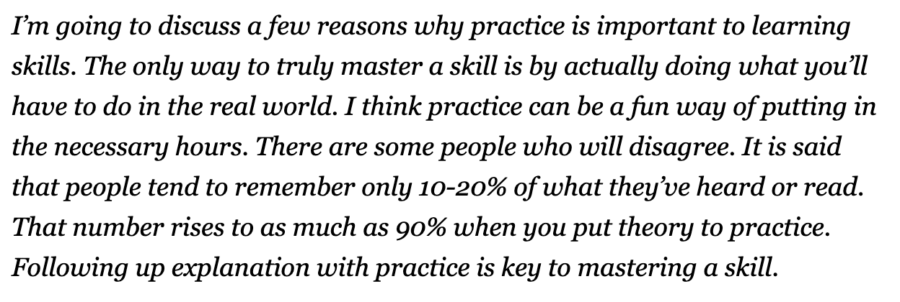
INSTRUCTION: READ THE FOLLOWING TEXT. CAN WE IMPROVE IT? HOW?

Slide 44
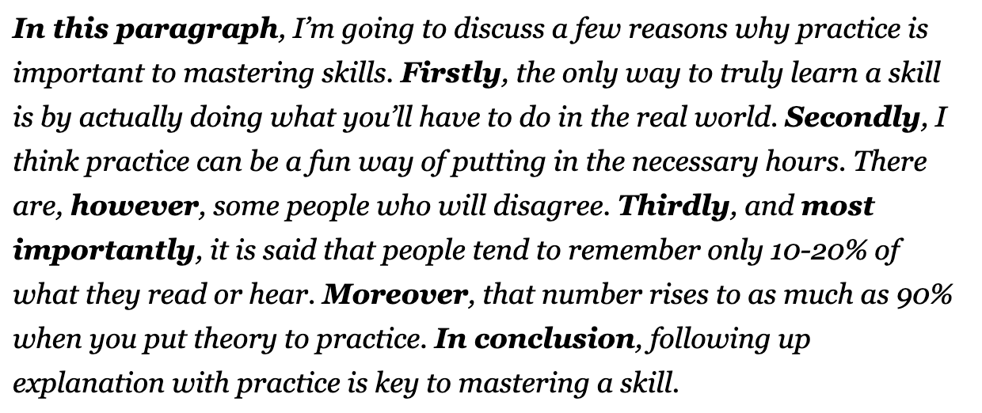
IMPROVED TEXT

Slide 45
LET’S PLAY
Go to Quizizz and practice some sentence connectors.
https://quizizz.com/admin/quiz/6255b2230e1522001d2e1bb2

