Slide 1
50:50
15
$1 Million
14
$500,000
Welcome to Who Wants to be a Millionaire
13
$250,000
12
$125,000
11
$64,000
10
$32,000
9
$16,000
8
$8,000
7
$4,000
6
$2,000
5
$1,000
4
$500
3
$300
2
$200
1
$100

Slide 2
15
$1 Million
14
$500,000
13
$250,000
12
$125,000
11
$64,000
10
$32,000
9
$16,000
8
$8,000
7
$4,000
6
$2,000
5
$1,000
4
$500
3
$300
2
$200
1
$100

Slide 3
15
$1 Million
14
$500,000
I think Programming is ______ English
13
$250,000
12
$125,000
11
$64,000
10
$32,000
9
$16,000
8
$8,000
7
$4,000
A
6
$2,000
5
$1,000
4
$500
3
$300
2
$200
50:50
1
$100
A: harder than
B: the hardest
C: easy
D: easier
Notes:
‹#›

Slide 4
15
$1 Million
14
$500,000
13
$250,000
12
$125,000
11
$64,000
10
$32,000
9
$16,000
8
$8,000
7
$4,000
6
$2,000
5
$1,000
4
$500
3
$300
2
$200
1
$100

Slide 5
15
$1 Million
14
$500,000
The _________ brand is Apple
13
$250,000
12
$125,000
11
$64,000
10
$32,000
9
$16,000
8
$8,000
7
$4,000
B
6
$2,000
5
$1,000
4
$500
3
$300
2
$200
50:50
1
$100
A: cheaper
B: most expensive
C: cheapest
D: the better

Slide 6
15
$1 Million
14
$500,000
13
$250,000
12
$125,000
11
$64,000
10
$32,000
9
$16,000
8
$8,000
7
$4,000
6
$2,000
5
$1,000
4
$500
3
$300
2
$200
1
$100

Slide 7
15
$1 Million
14
$500,000
13
$250,000
Technology makes the world ______
12
$125,000
11
$64,000
10
$32,000
9
$16,000
8
$8,000
7
$4,000
B
6
$2,000
5
$1,000
4
$500
3
$300
2
$200
50:50
1
$100
A: best
B: better
C: badder
D: worse

Slide 8
15
$1 Million
14
$500,000
13
$250,000
12
$125,000
11
$64,000
10
$32,000
9
$16,000
8
$8,000
7
$4,000
6
$2,000
5
$1,000
4
$500
3
$300
2
$200
1
$100

Slide 9
15
$1 Million
14
$500,000
13
$250,000
12
$125,000
coding in phyton is _________ coding in java
11
$64,000
10
$32,000
9
$16,000
8
$8,000
7
$4,000
D
6
$2,000
5
$1,000
4
$500
3
$300
2
$200
50:50
1
$100
A: the most difficult
B: difficult
C: easy
D: more difficult than

Slide 10
15
$1 Million
14
$500,000
13
$250,000
12
$125,000
11
$64,000
10
$32,000
9
$16,000
8
$8,000
7
$4,000
6
$2,000
5
$1,000
4
$500
3
$300
2
$200
1
$100

Slide 11
15
$1 Million
14
$500,000
13
$250,000
12
$125,000
Intel Core i3 is a ________ processor than AMD R7
11
$64,000
10
$32,000
9
$16,000
8
$8,000
7
$4,000
B
6
$2,000
5
$1,000
4
$500
3
$300
2
$200
50:50
1
$100
A: faster
B: slower
C: fastest
D: slowest

Slide 12
Congratulations!
Congratulations!
Congratulations!
You’ve Reached
the $1,000
Milestone!

Slide 13
15
$1 Million
14
$500,000
13
$250,000
12
$125,000
11
$64,000
10
$32,000
9
$16,000
8
$8,000
7
$4,000
6
$2,000
5
$1,000
4
$500
3
$300
2
$200
1
$100

Slide 14
15
$1 Million
14
$500,000
13
$250,000
MacBook Pro 15” is ______ MacBook Air 13”
12
$125,000
11
$64,000
10
$32,000
9
$16,000
8
$8,000
7
$4,000
D
6
$2,000
5
$1,000
4
$500
3
$300
2
$200
50:50
1
$100
A: as big as
B: smaller than
C: uglier
D: bigger than

Slide 15
15
$1 Million
14
$500,000
13
$250,000
12
$125,000
11
$64,000
10
$32,000
9
$16,000
8
$8,000
7
$4,000
6
$2,000
5
$1,000
4
$500
3
$300
2
$200
1
$100

Slide 16
15
$1 Million
This is ______washing machine on the market
14
$500,000
13
$250,000
12
$125,000
11
$64,000
10
$32,000
9
$16,000
8
$8,000
7
$4,000
A
6
$2,000
5
$1,000
4
$500
3
$300
2
$200
50:50
1
$100
A: the worst
B: the worse
C: the better
D: good

Slide 17
15
$1 Million
14
$500,000
13
$250,000
12
$125,000
11
$64,000
10
$32,000
9
$16,000
8
$8,000
7
$4,000
6
$2,000
5
$1,000
4
$500
3
$300
2
$200
1
$100

Slide 18
15
$1 Million
14
$500,000
My keyboard is ________ yours.
13
$250,000
12
$125,000
11
$64,000
10
$32,000
9
$16,000
8
$8,000
7
$4,000
D
6
$2,000
5
$1,000
4
$500
3
$300
2
$200
50:50
1
$100
A: less better
B: good than
C: best
D: as good as

Slide 19
15
$1 Million
14
$500,000
13
$250,000
12
$125,000
11
$64,000
10
$32,000
9
$16,000
8
$8,000
7
$4,000
6
$2,000
5
$1,000
4
$500
3
$300
2
$200
1
$100

Slide 20
15
$1 Million
14
$500,000
The _______place where you can buy that laptop is two hours away from here
13
$250,000
12
$125,000
11
$64,000
10
$32,000
9
$16,000
8
$8,000
7
$4,000
A
6
$2,000
5
$1,000
4
$500
3
$300
2
$200
50:50
1
$100
B: more near
A: nearest
C: near from
D: nearest from

Slide 21
15
$1 Million
14
$500,000
13
$250,000
12
$125,000
11
$64,000
10
$32,000
9
$16,000
8
$8,000
7
$4,000
6
$2,000
5
$1,000
4
$500
3
$300
2
$200
1
$100

Slide 22
15
$1 Million
14
$500,000
One of the ___________ things when programming, is to analyze any kind of bugs.
13
$250,000
12
$125,000
11
$64,000
10
$32,000
9
$16,000
8
$8,000
7
$4,000
B
6
$2,000
5
$1,000
4
$500
3
$300
2
$200
50:50
$100
1
A: Irrelevant
B: most important
C: better
D: worst

Slide 23
Congratulations!
Congratulations!
Congratulations!
You’ve Reached
the $32,000
Milestone!

Slide 24
15
$1 Million
14
$500,000
13
$250,000
12
$125,000
11
$64,000
10
$32,000
9
$16,000
8
$8,000
7
$4,000
6
$2,000
5
$1,000
4
$500
3
$300
2
$200
1
$100

Slide 25
15
$1 Million
14
$500,000
People in Colombia are ______ than people in the US
13
$250,000
12
$125,000
11
$64,000
10
$32,000
9
$16,000
8
$8,000
7
$4,000
C
6
$2,000
5
$1,000
4
$500
3
$300
2
$200
50:50
1
$100
A: polite
B: most polite
C: more polite
D: the most polite

Slide 26
15
$1 Million
14
$500,000
13
$250,000
12
$125,000
11
$64,000
10
$32,000
9
$16,000
8
$8,000
7
$4,000
6
$2,000
5
$1,000
4
$500
3
$300
2
$200
1
$100

Slide 27
15
$1 Million
14
$500,000
I want to be ________ you are
13
$250,000
12
$125,000
11
$64,000
10
$32,000
9
$16,000
8
$8,000
7
$4,000
C
6
$2,000
5
$1,000
4
$500
3
$300
2
$200
50:50
1
$100
A: most smart
B: smart
C: as smart as
D: smarter

Slide 28
15
$1 Million
14
$500,000
13
$250,000
12
$125,000
11
$64,000
10
$32,000
9
$16,000
8
$8,000
7
$4,000
6
$2,000
5
$1,000
4
$500
3
$300
2
$200
1
$100

Slide 29
15
$1 Million
14
$500,000
13
$250,000
12
$125,000
In my opinion, _______ coding language is C++
11
$64,000
10
$32,000
9
$16,000
8
$8,000
7
$4,000
B
6
$2,000
5
$1,000
4
$500
3
$300
2
$200
50:50
1
$100
A: the easy
B: the best
C: as good as
D: the good

Slide 30
15
$1 Million
14
$500,000
13
$250,000
12
$125,000
11
$64,000
10
$32,000
9
$16,000
8
$8,000
7
$4,000
6
$2,000
5
$1,000
4
$500
3
$300
2
$200
1
$100

Slide 31
15
$1 Million
14
$500,000
The teacher is ________ than I am
13
$250,000
12
$125,000
11
$64,000
10
$32,000
9
$16,000
8
$8,000
7
$4,000
D
6
$2,000
5
$1,000
4
$500
3
$300
2
$200
50:50
1
$100
A: as tired as
B: exhausted
C: the most exhausted
D: more exhausted

Slide 32
15
$1 Million
14
$500,000
13
$250,000
12
$125,000
11
$64,000
10
$32,000
9
$16,000
8
$8,000
7
$4,000
6
$2,000
5
$1,000
4
$500
3
$300
2
$200
1
$100

Slide 33
15
$1 Million
14
$500,000
The _________ person in this class is Jhon
13
$250,000
12
$125,000
11
$64,000
10
$32,000
9
$16,000
8
$8,000
7
$4,000
C
6
$2,000
5
$1,000
4
$500
3
$300
2
$200
50:50
1
$100
A: young
B: younger
C: youngest
D: older

Slide 34
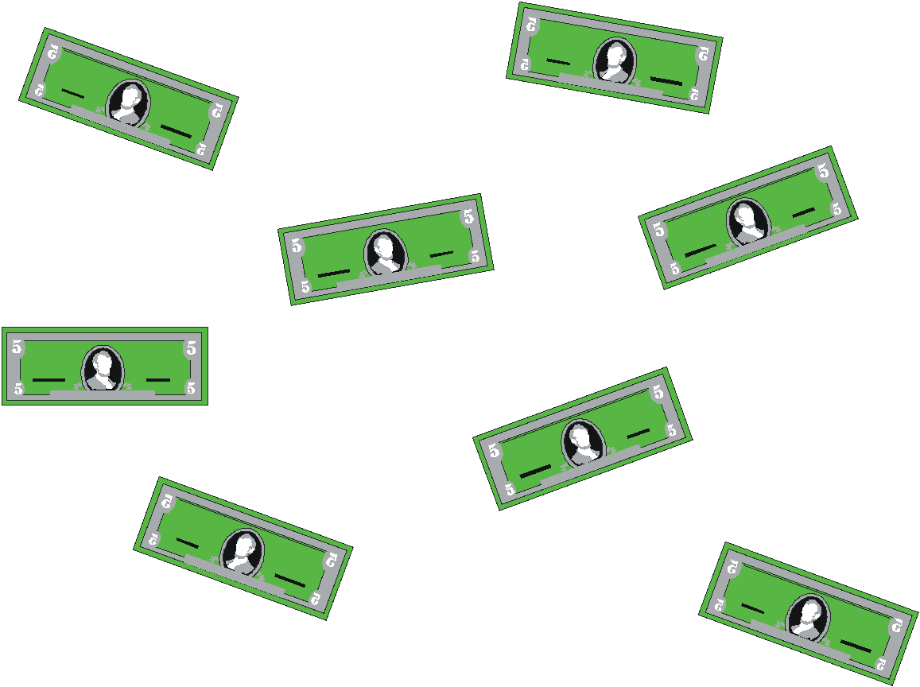
YOU WIN $1 MILLION DOLLARS!

