Slide 2
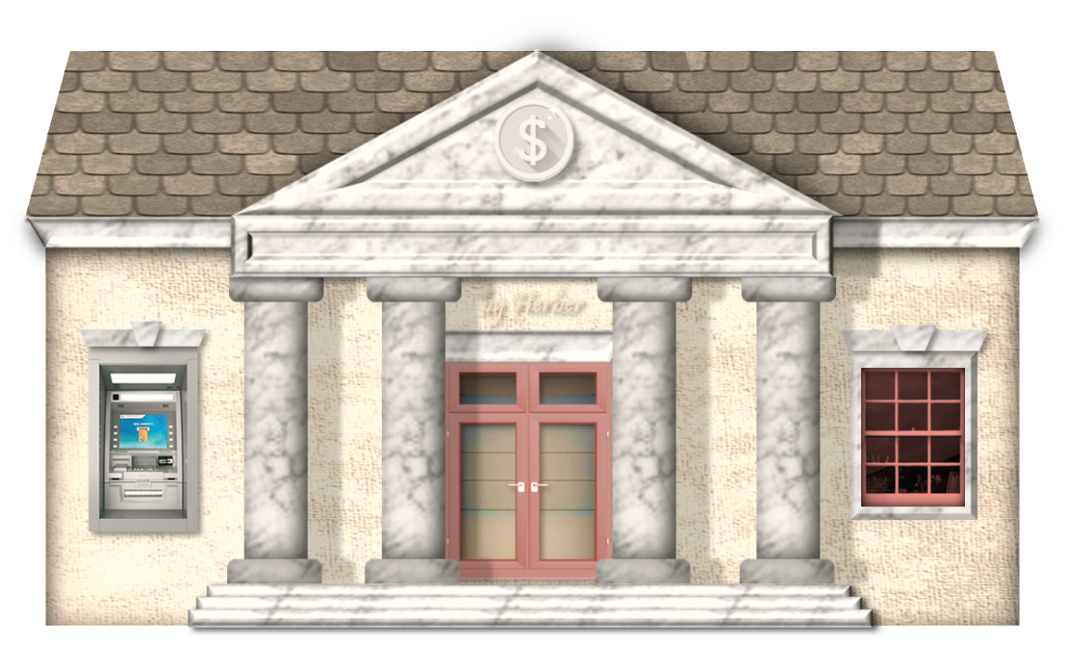
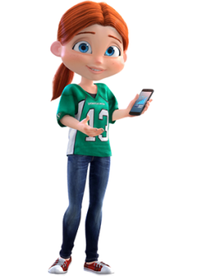
This is the bank was robbed yesterday.
which
which
who
whose
This is the girl called the police.
who
which
who
whose

Slide 3
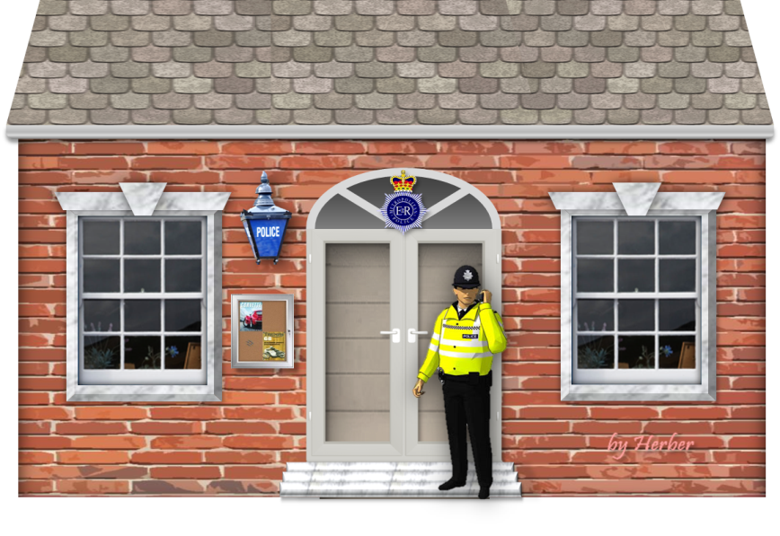
This is the police station she reported the theft.
where
whose
when
where

Slide 4
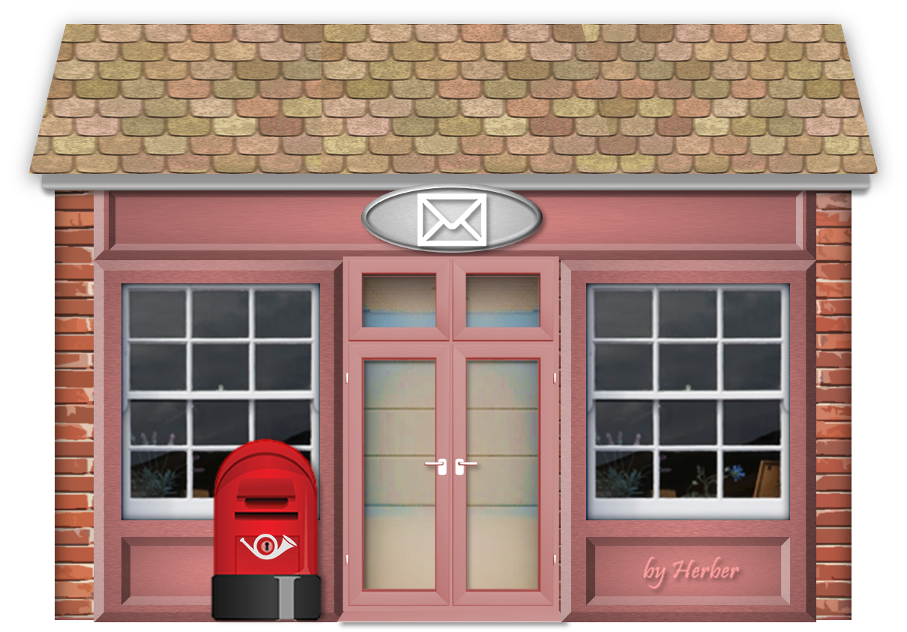
That man, lives next door, works in the post office.
who
which
who
whose

Slide 5
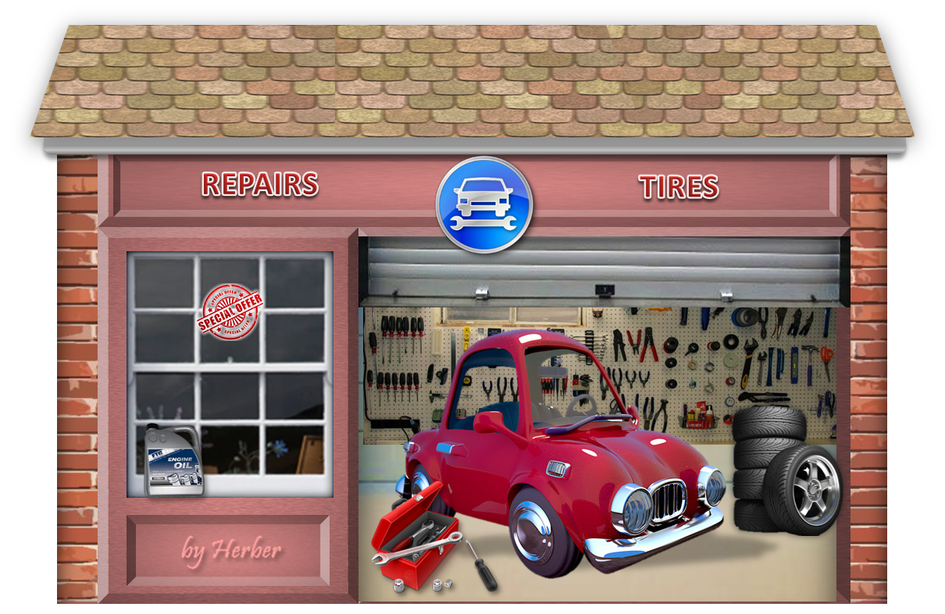
The girl, car is in the garage, is phoning home.
whose
which
whose
who

Slide 6
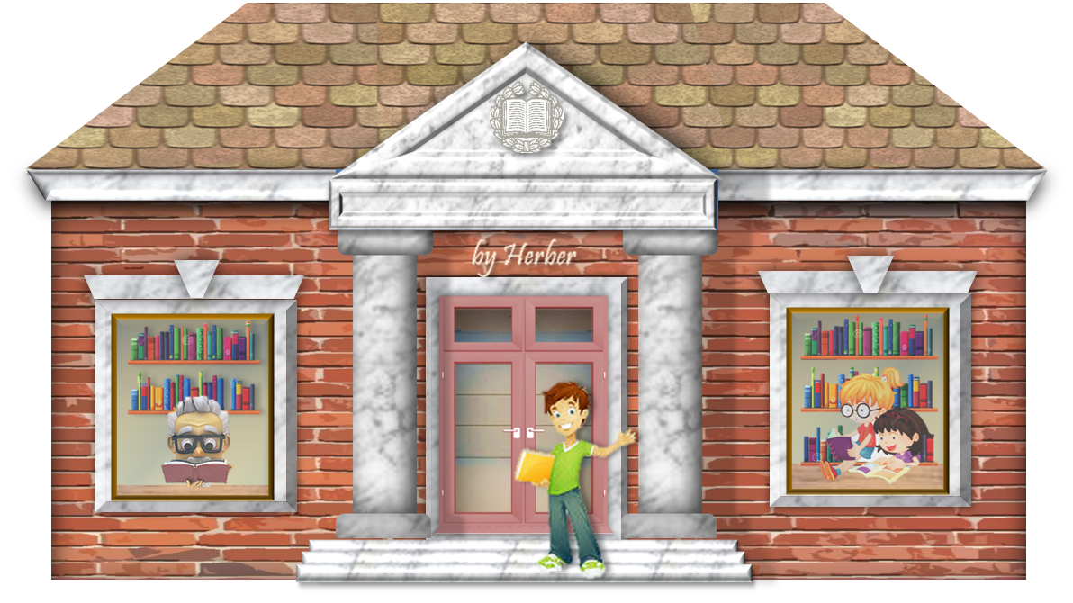
This is the library I usually go to study
and borrow some books.
where
whose
when
where

Slide 7
The old man, is driving the red lorry, is my grandad.
who
which
who
whose

Slide 8
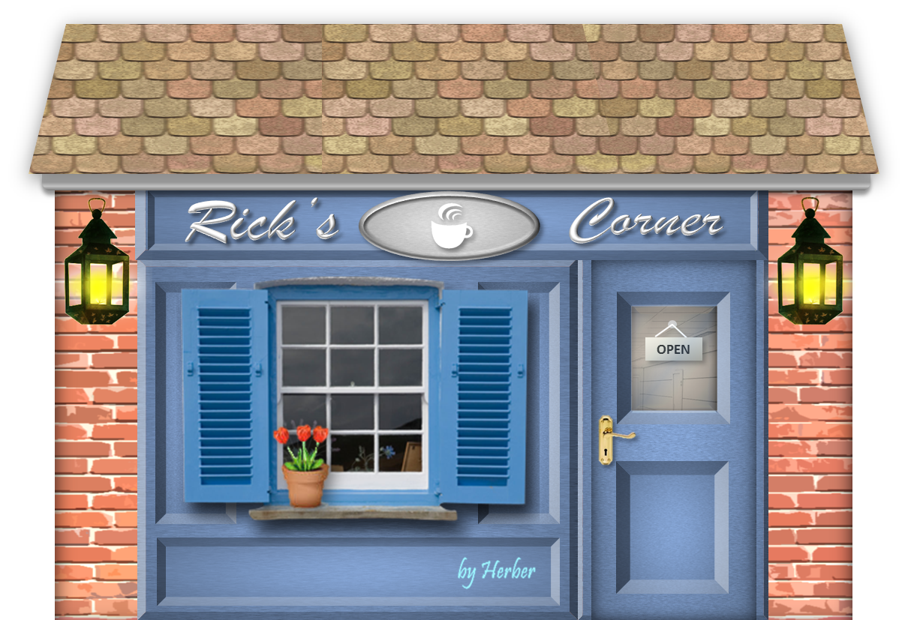
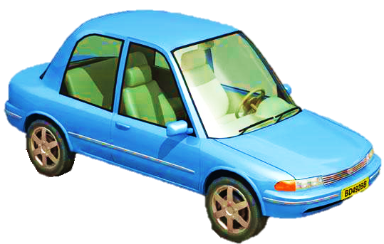
The man, car is next to the café, is waiting for you.
whose
which
that
whose

Slide 9
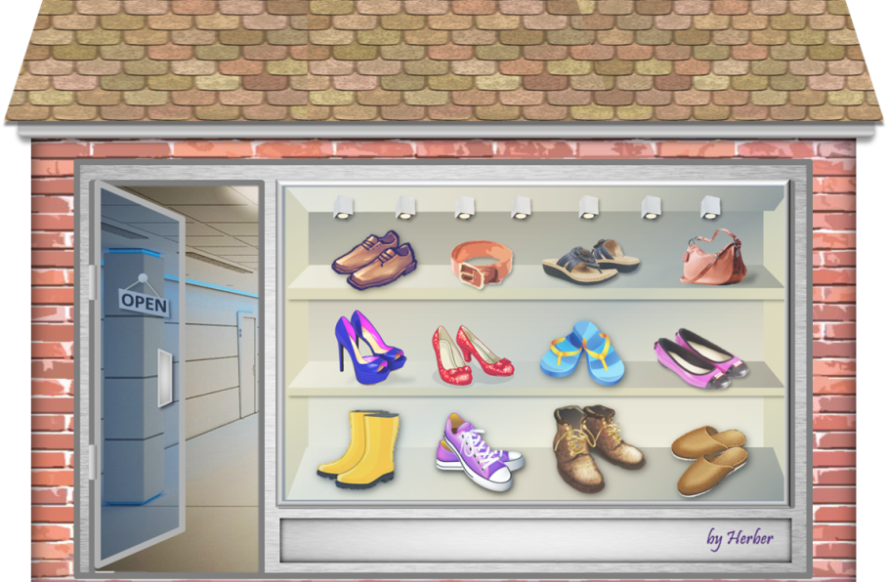
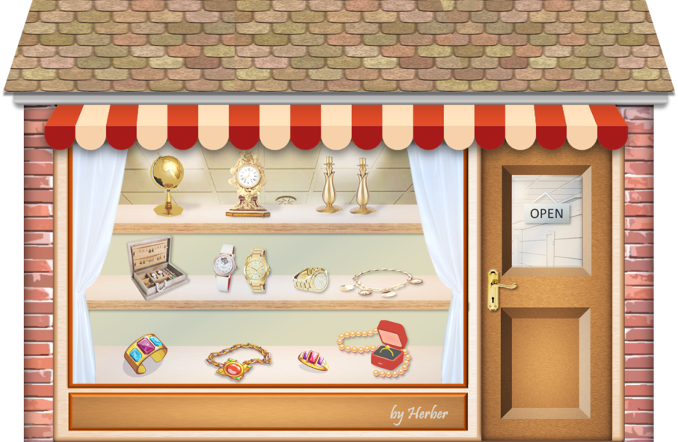
The shop he bought his new shoes is next to the jeweller’s.
where
whose
that
where

Slide 10
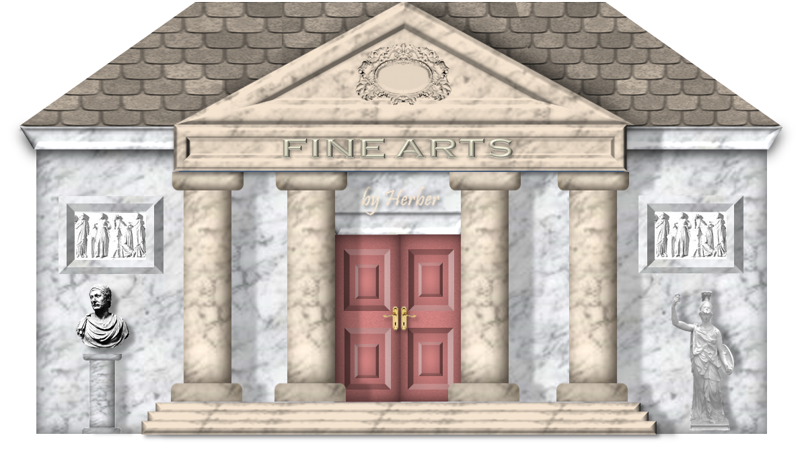
Monday is the day the museum is closed.
when
when
which
where
EXIT

