Slide 1
UNIT 1- EXPANDING KNOWLEDGE
Región 3 Cauca Y Nariño

Slide 2
PRESENTATION OF THE UNIT 1
In this unit, you will learn useful technical vocabulary which will help you enhance reading and writing skills, fostering critical thinking and global awareness.

Slide 3
TECHNOLOGY PHRASAL VERBS
Log in/on
To write your password in order to use your computer.
I can't log in, have you changed your password?
Log out/off
To do the necessary actions to finish using your computer.
Don't forget to log out when you're done checking your email.
Back up
To make a copy of the information stored on a computer.
It is highly recommended to back up important files.
Wipe out
To remove the information stored on a computer.
A virus got into my computer and wiped out the hard disk.

Slide 4
Sign in
Register once you've got an account, that is to put your user name and password.
Every time I want to enter my email I have to sign in.
Set up
To do all the necessary actions to make a piece of equipment ready for use.
The technician's setting up our modem.
Sign up
Register for the first time, create an account.
If we want a free trial of the course we have to sign up.
Pop up
Appear.
I hate it when ads keep popping up.

Slide 5
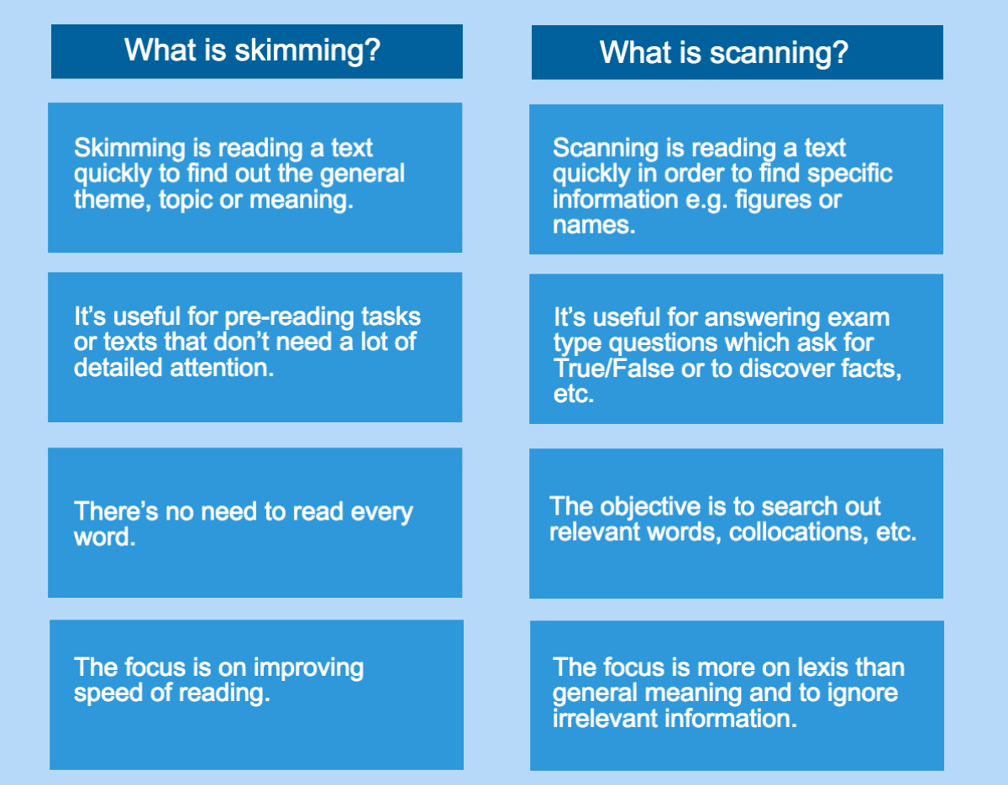
SCANNING vs SKIMMING

Slide 6
ARTIFICIAL INTELLIGENCE USEFUL TERMINOLOGY
Artificial Intelligence (AI):
The simulation of human intelligence in machines programmed to perform tasks that normally require human intelligence, such as visual perception, speech recognition, decision-making, and language translation.
Chatbot:
A computer program designed to simulate conversation with human users, especially over the Internet.
Bigdata:
Extremely large, and complex datasets that cannot be easily managed, or processed using traditional data processing applications.
Natural Language Processing (NLP):
A branch of AI that enables computers to understand, interpret, and generate human language in a way that is both valuable, and meaningful.
Machine Learning (ML):
A subset of AI that involves the use of algorithms, and statistical models to enable computers to improve their performance on a task without being explicitly programmed.
Algorithm:
A set of rules, or instructions followed by a computer to solve a problem, or perform a specific task.
Internet of Things (IoT):
The network of interconnected physical devices (objects or "things") embedded with sensors, software, and other technologies to exchange data with other devices, and systems over the Internet.
Cybersecurity:
The practice of protecting computer systems, networks, and programs from digital attacks, theft, and damage.

Slide 7
READING – THE AMAZING WORLD OF ARTIFICAL INTELLIGENCE

Slide 8
Artificial Intelligence (AI) is one of the most exciting and rapidly evolving fields in technology today. At its core, AI involves the development of computer systems that can perform tasks that would normally require human intelligence. From speech recognition, and language translation to decision-making, and pattern recognition, the possibilities of AI are almost endless. But what exactly is AI, and how does it work? In this article, we’ll take a journey into the amazing world of AI and explore some of its most fascinating aspects.
The Amazing World of Artificial Intelligence
Fact 1: What is AI?
AI refers to the development of computer systems that can perform tasks that would normally require human intelligence. These tasks might include recognizing speech, translating languages, or making decisions based on complex data. At its core, AI is all about teaching computers to think, and learn like humans, using a combination of algorithms, and data to analyze, and interpret information.

Slide 9
Fact 2: The History of AI
AI has a long and fascinating history, dating back more than 50 years. Early developments in AI included the first chess-playing computer program in 1951, and the first AI program that could converse with humans in natural language in the 1960s. Since then, AI has continued to evolve and grow, with new breakthroughs in machine learning, natural language processing, and other areas.
Fact 3: Applications of AI
Today, AI is used in a wide range of applications, from virtual personal assistants like Siri and Alexa to facial recognition technology, self-driving cars, and medical diagnosis. In fact, AI is transforming many industries, from finance, and healthcare to manufacturing, and transportation. As technology continues to evolve, we can expect to see even more exciting applications in the years to come.

Slide 10
Fact 4: Types of AI
There are two main types of AI: narrow or weak AI, which is designed to perform a specific task or set of tasks, and general or strong AI, which would have the ability to perform any intellectual task that a human can. While narrow AI is already in use in many applications, the development of general AI is still a long way off.
Fact 5: Ethical Concerns
While AI has the potential to bring many benefits, such as increased efficiency, and accuracy in decision-making, it also raises ethical concerns around issues such as job displacement, bias in decision-making, and control over the technology. As AI continues to evolve, and become more pervasive, it will be important for society to grapple with these issues, and ensure that the technology is used in responsible, and ethical ways.
In conclusion, AI is a complex, and fascinating field that has the potential to transform many aspects of our lives. By understanding the basics of how AI works, and how it’s being used today, we can prepare ourselves for the exciting changes that lie ahead. Who knows, maybe one day we’ll even have robots as friends!
Taken from:
https://medium.com/my-journey-to-the-cloud/the-amazing-world-of-ar tificial-intelligence-3fa0513decde

Slide 11
READING COMPREHENSION ACTIVITY
QUIZIZZ

Slide 12
TECHNOLOGY IDIOMS VOCABULARY
To Pull The Plug
Meaning: to stop something in its tracks, to stop it immediately
Example: The business was not doing very well in the last 3 months, and the owners decided to pull the plug.
To Get Your Wires Crossed
Meaning: to misunderstand somebody; to become confused
Examples:I think we’ve got our wires crossed here. What I’m talking about is next week’s meeting. What you seem to be talking about was last week’s meeting.

Slide 13
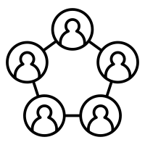
To Be On The Same Wavelength
It is the opposite of ‘to get your wires crossed’
Meaning: to have the same thoughts, the same intentions; to understand exactly the same thing, to be in agreement with somebody
Example:
After the first few brief conversations, we already knew that we were on the same wavelength.
To Be Right On The Button
Meaning: to be exactly right
Example:
He confirmed her suspicions; he was right on the button.

Slide 14
USEFUL BLOCKCHAIN TERMINOLOGY
Blockchain:
A digital ledger database that encrypts recorded contents into a sequence of blocks, distributed across a network of participating computers (nodes).
Immutable:
Entries recorded in the blockchain cannot be changed once they are recorded, ensuring the permanence of data.
Decentralized:
Capable of operating without the need for third-party entities, whether human or not, providing independence from central authorities.
Distributed:
All participating computers in the network have a copy of the blockchain ledger, enhancing accessibility and redundancy.

Slide 15
Cryptography:
Cryptography is the art of securing information by transforming it into ciphertext, making it unintelligible to unintended recipients. The process involves using algorithms or mathematical operations to change plaintext into a disguised form.
Digital Certificate:
An electronic document that uses cryptography to bind the identity of an entity, such as a person or a website, to a public key.

Slide 16
READING – UNDERSTANDING BLOCKCHAIN TECHNOLOGY
LINK: https://builtin.com/blockchain

Slide 17
READING COMPREHENSION ACTIVITY
KAHOOT

Slide 18
FORUM DISCUSSION QUESTIONS
How is artificial intelligence helping us today?
What is the difference between artificial intelligence and human intelligence?
What would our life be like without artificial intelligence?
What are the benefits of blockchain technology?
What are the different types of blockchains

